Slide 1


An Introduction to Vectors
Representing Magnitude and Direction
Example
Speed + Direction
= Velocity

Slide 2
Scalars vs. Vectors
Some quantities can be described by a single number (magnitude), while others require both a magnitude and a direction.
Scalar Quantities
Vector Quantities
Represented by a simple number.
Represented by magnitude and direction.
Time
Velocity
Distance
Acceleration
Mass
Force
Displacement

Slide 3
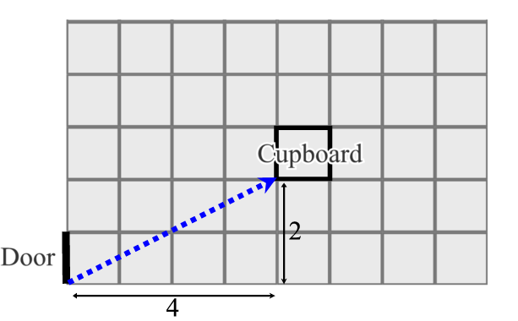
Representing Vectors: A Simple Example
Imagine moving across a tiled room. To get from the door to the cupboard, you might move four tiles to the right and two tiles up. This displacement can be represented by the vector (4, 2).
The order is crucial; moving (4, 2) is different from moving
(2, 4).

Slide 4
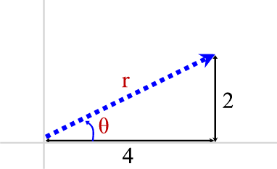

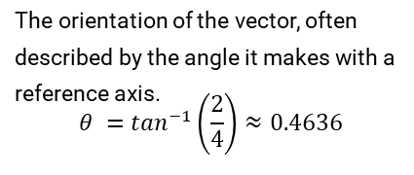
Magnitude and Direction
For the vector (4, 2), we can calculate its magnitude (length) and define its direction.
Magnitude
Direction
The length of the vector, found using Pythagoras' theorem.
The orientation of the vector, often described by the angle it makes with a reference axis.
$$θ =\tan^{−1}\left(\frac{2}{4}\right)≈0.4636$$
Magnitude $r = √(4² + 2²) = √20 ≈ 4.47$

Slide 5
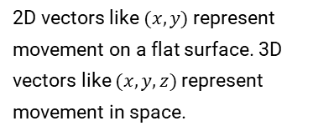
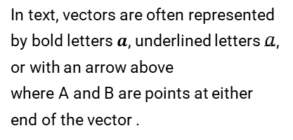
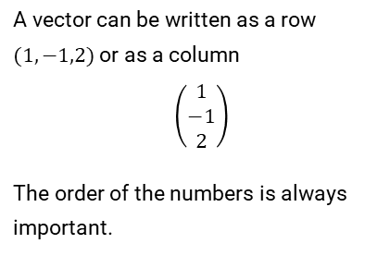
Vector Dimensions and Notation
Vectors can be written as rows or columns. Their dimension is the number of elements they contain.
2D & 3D Vectors
Row and Column Notation
Symbolic Notation
2D vectors like $(x, y)$represent movement on a flat surface. 3D vectors like $(x, y, z)$represent movement in space.
A vector can be written as a row
$(1,−1,2)$or as a column
$$\left(\begin{matrix}1 \\ −1 \\ 2\end{matrix}\right)$$
The order of the numbers is always important.
In text, vectors are often represented by bold letters $a$, underlined letters $a$, or with an arrow above
where A and B are points at either end of the vector .

Slide 6
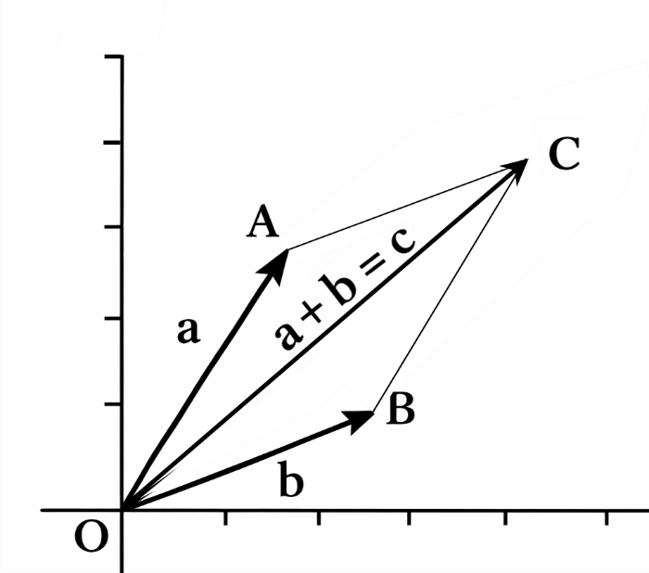
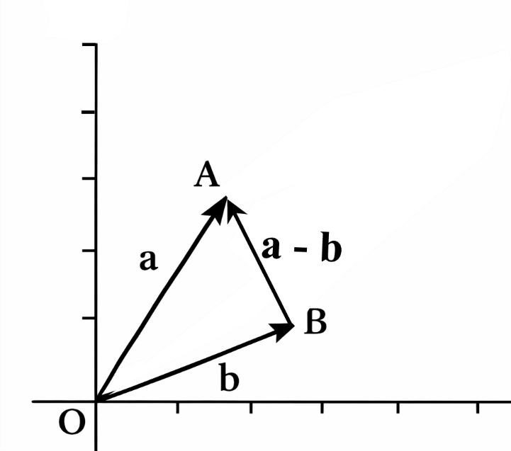
Vector Operations: Addition and Subtraction
Addition
Subtraction
To add two vectors, add their corresponding components.
To subtract a vector, subtract its corresponding components.
$$(2, 3) + (4, 2) = (2+4, 3+2) = (6, 5)$$
$$(2, 3) − (4, 2) = (2−4, 3−2) = (−2, 1)$$

Slide 7
Polar Coordinates
Instead of $(x, y)$ components, a 2D vector can be described by its length ($r$) and its angle ($θ$) relative to the x-axis.
From Rectangular $(x, y)$to Polar $(r, θ)$
From Polar $(r, θ)$to Rectangular $(x, y)$
Magnitude: $r = √(x² + y²)$
$x$-component: $x = r cos⁡(θ)$
Angle: $θ = \tan^{−1}\left(\frac{y}{x}\right)$(adjusting for quadrant)
$y$-component: $y = r sin⁡(θ)$
Note: To add vectors in polar form, first convert them to rectangular form, add the components, then convert back.

Slide 8
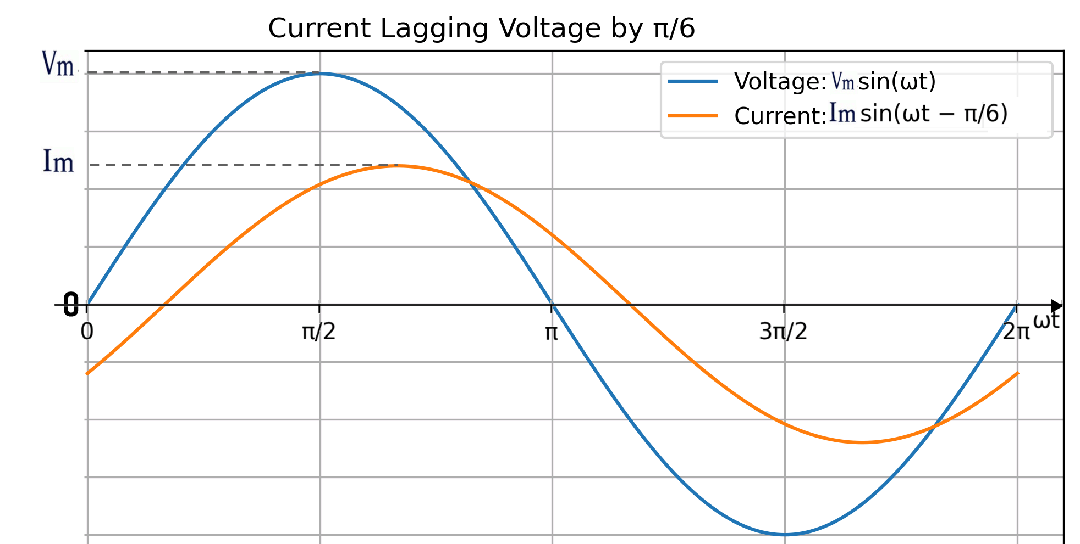
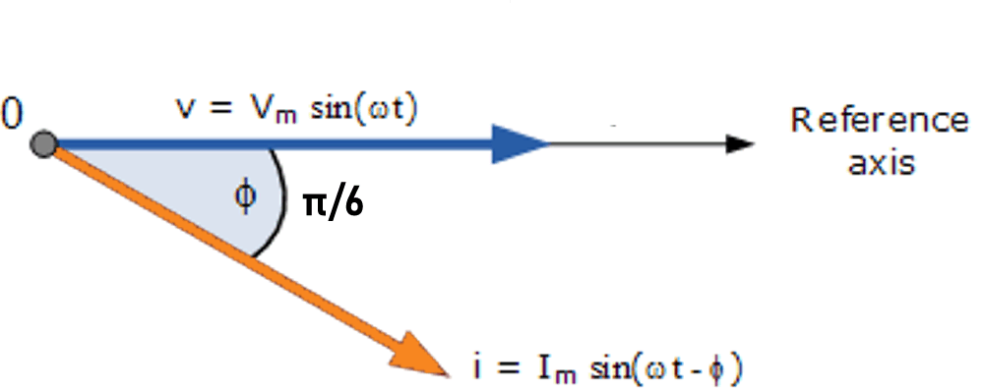
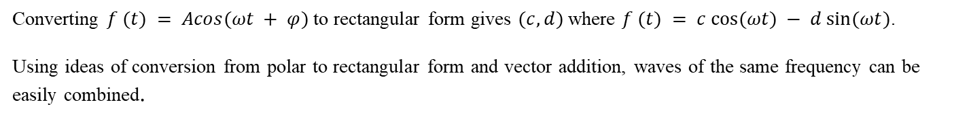
Application of Vectors to Represent Waves (phasors)
Waves of a fixed frequency can be represented by phasors giving the amplitude and phase.
$f (t) = Acos(ωt + φ)$can be represented by its amplitude and phase $A∠φ$.
Electrical Circuits Example
Phasor Diagram of a Sinusoidal Waveform
The current phasor lags the voltage phasor by the angle (Φ)
Converting $f (t) = Acos(ωt + φ)$ to rectangular form gives $(c,d)$where $f (t) = c cos⁡(ωt) − d sin⁡(ωt)$.
Using ideas of conversion from polar to rectangular form and vector addition, waves of the same frequency can be easily combined.

Slide 9


Scalar Multiplication and Unit Vectors
Scalar Multiplication
Unit Vectors
Multiplying a vector by a scalar changes its length but not its direction. For example, $3a$ is three times as long as $a$.
A unit vector has a length of 1 and is used to specify a direction. To find the unit vector (r̂) for a vector (r), divide r by its own magnitude.
$$3 (1, −2) = (3, −6)$$
$$\hat{r}=\frac{r}{\left|r\right|}$$

Slide 10


The Scalar (Dot) Product
The scalar product (or dot product) of two vectors results in a single number (a scalar).
Calculation
Geometric Meaning
$a= (a₁,a₂) , b =$($b₁,b₂$ )
$$a ⋅ b = a₁b₁ + a₂b2$$
$$a ⋅ b = |a| |b| cos⁡(θ)$$
This is useful for finding the angle (θ) between two vectors.
If $a ⋅ b = 0$, the vectors are at right angles (orthogonal).
Example: $(2, 3) ⋅ (1, 2) = (2)(1) + (3)(2) = 8$

Slide 11
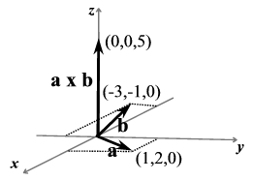
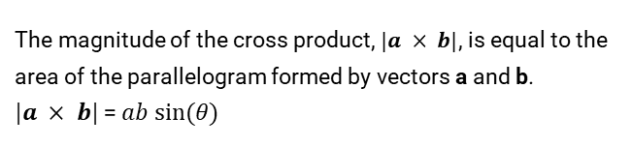
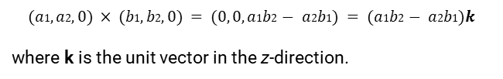
The Vector (Cross) Product
Definition
Application: Area
The magnitude of the cross product, $|a × b|$, is equal to the area of the parallelogram formed by vectors a and b.
$|a × b|$= $ab sin⁡(θ)$
The vector product (or cross product) creates a new vector that is perpendicular to the plane containing the two original vectors.
$$(a1, a2, 0) × (b1, b2, 0) = (0, 0, a1b2 − a2b1) = (a1b2 − a2b1)k$$
where k is the unit vector in the z-direction.

Slide 12
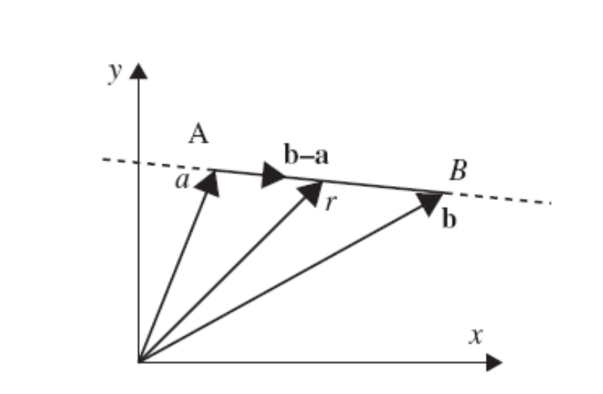
Vector Equation of a Line
The equation of a line can be expressed using vectors. It requires a point on the line and a vector that gives the direction of the line.
The Formula
$$r = a + λ(b − a)$$
$r$ is any point on the line
$a$ is the position vector of is a known point on the line
$b$ is the position vector of another known point on the line
$(b − a)$is the direction vector of the line
$λ$ is a scalar parameter

Slide 13
Summary
Vectors possess both magnitude and direction. Scalars have magnitude only.
Vector operations include addition, subtraction, and scalar multiplication.
Unit vectors specify direction with a magnitude of 1.
The Scalar (Dot) Product results in a number and can be used to find angles between two vectors.
The Vector (Cross) Product results in a new vector, perpendicular to the plane of the original vectors, and the magnitude of the cross product can be used to find the area of the parallelogram.
A 2D Vectors can be represented in polar form by finding its magnitude (length) and angle it makes to a reference axis: $(r, θ)$or $r∠ θ$
Waves of a fixed frequency can be represented by phasors giving the amplitude and phase. This representation of waves as phasors mean simple vector addition and algebra can be used.
The vector equation of a line can be found using the position vector of any point on the line and its direction vector.

