Slide 1

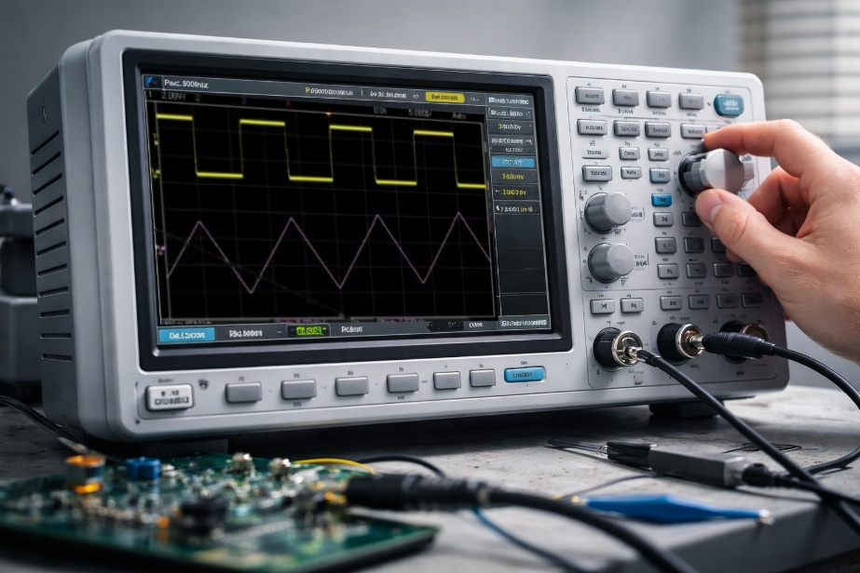
Integration

Slide 2
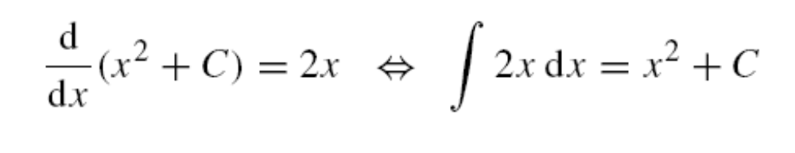
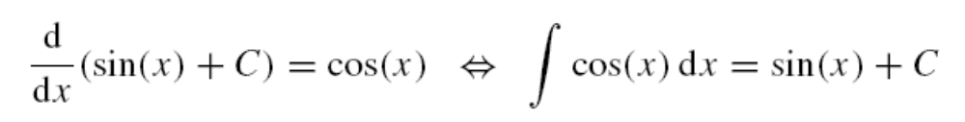




What is Integration?
Integration is the inverse process of differentiation. If we know the rate of change of a quantity (its derivative), integration allows us to find the original quantity. For example, while velocity is the derivative of distance with respect to time, distance is the integral of velocity with respect to time.
Function
Derivative
Integral
Function
$$x^{2}+C$$
$$2x$$
$$\sin\left(x\right)+C$$
$$cos⁡(x)$$
These can be written as:

Slide 3
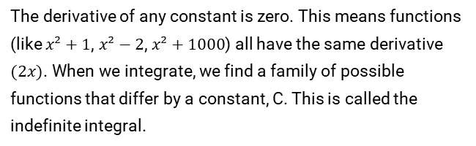
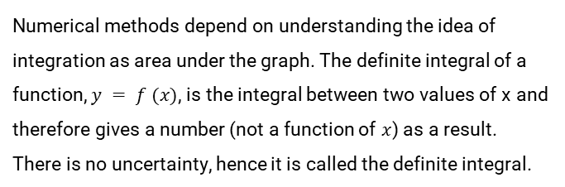
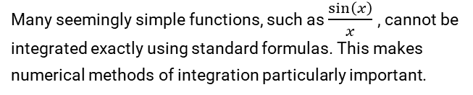
Two Key Challenges in Integration
1. The Constant of Integration
2. Non-Integrable Functions
The derivative of any constant is zero. This means functions (like $x²+1$, $x²−2$, $x²+1000$) all have the same derivative $(2x)$. When we integrate, we find a family of possible functions that differ by a constant, C. This is called the indefinite integral.
Many seemingly simple functions, such as $\frac{\sin\left(x\right)}{x}$, cannot be integrated exactly using standard formulas. This makes numerical methods of integration particularly important.
Numerical methods depend on understanding the idea of integration as area under the graph. The definite integral of a function, $y = f (x)$, is the integral between two values of x and therefore gives a number (not a function of $x$) as a result. There is no uncertainty, hence it is called the definite integral.
Once the unknown constant is replaced by
some value to fit a certain problem; we have the particular integral.

Slide 4
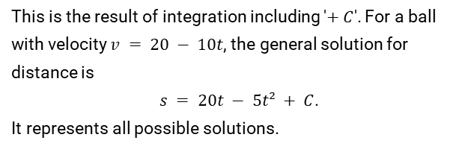
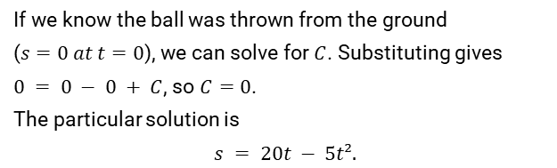
General vs. Particular Solutions
To find the specific constant 'C' for a particular problem, we use known information or initial conditions.
General Solution
Particular Solution
This is the result of integration including '$+ C$'. For a ball with velocity $v = 20 − 10t$, the general solution for distance is
$s = 20t − 5t² + C$.
It represents all possible solutions.
If we know the ball was thrown from the ground
($s=0 at t=0$), we can solve for $C$. Substituting gives
$0 = 0 − 0 + C$, so $C=0$.
The particular solution is
$$s = 20t − 5t².$$

Slide 5



Finding Integrals: Standard Forms
A table of standard integrals can be created by reversing a table of standard derivatives and adding the constant of integration, C.
$$f(x)$$
$$∫ f(x) dx$$
$$xⁿ (n ≠ −1)$$
$$\frac{xⁿ^{+1}}{\left(n+1\right)} + C$$
$$1$$
$$x + C$$
$$cos⁡(x)$$
$$sin⁡(x) + C$$
$$sin⁡(x)$$
$$−cos⁡(x) + C$$
$\frac{1}{1 + x^{2}}$
$$tan⁻¹(x) + C$$
$$\frac{1}{\sqrt{1−x^{2}} }$$
$$sin⁻¹(x) + C$$
$$− \frac{1}{\sqrt{1−x^{2}} }$$
$$cos⁻¹(x) + C$$

Slide 6

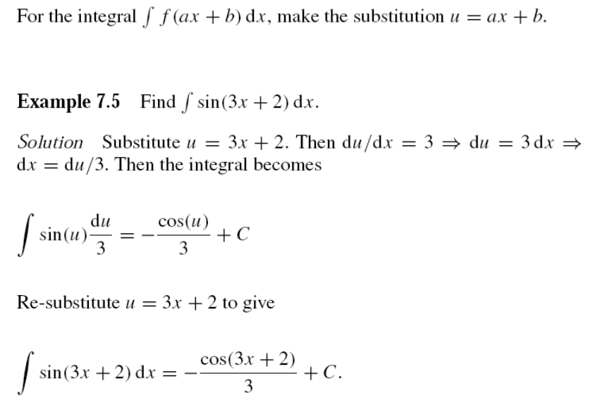
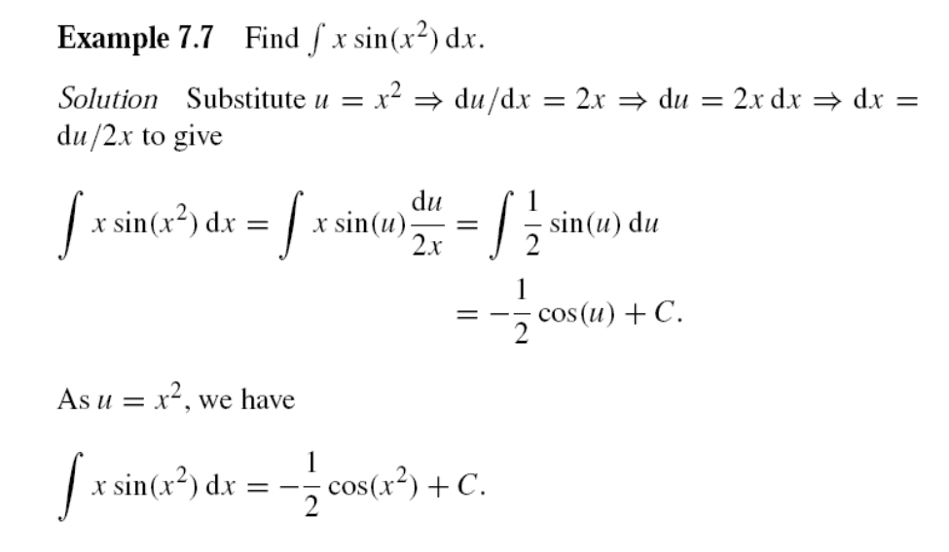
Integration by Substitution
This method, which reverses the differentiation chain rule, simplifies an integral by substituting part of the expression with a new variable, 'u'.
Linear Form: $∫ f(ax + b) dx$
Product Form: $∫ f(u) (du/dx) dx$
Look for a function multiplied by its derivative.

Slide 7
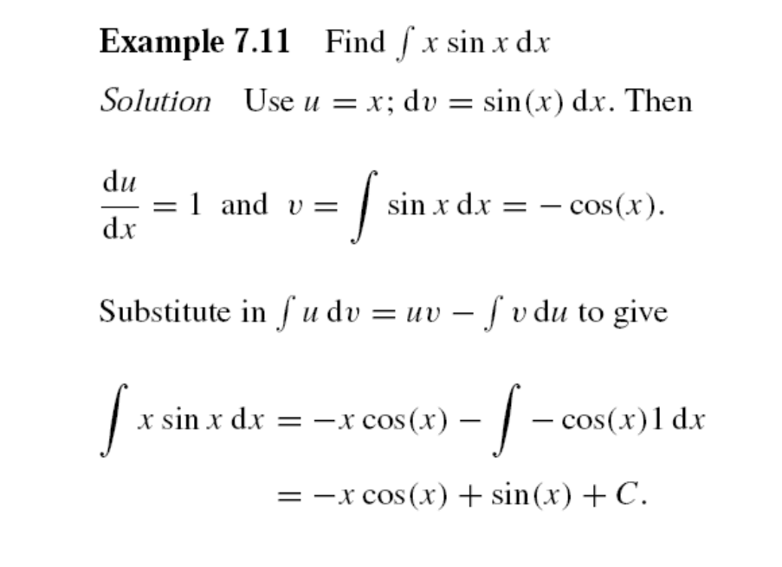
Integration by Parts
This integration by parts formula can be justified from the product rule for differentiation. This technique is used to integrate products of functions, like ∫ x sin(x) dx.
The Formula: $∫ u dv = uv − ∫ v du$
Split the integrand into two parts: '$u$' and '$dv$'.
Choose '$u$' to be something that simplifies when differentiated (e.g., $x$).
Choose '$dv$' to be the part you can integrate (e.g., $sin⁡(x) dx$).
Find $du$ (by differentiating $u$) and $v$ (by integrating $dv$).
Substitute these parts into the formula and solve the new, simpler integral.

Slide 8
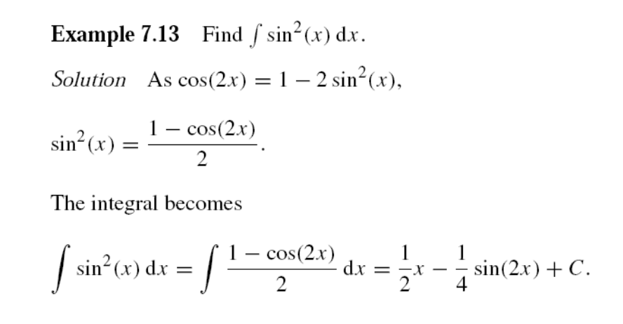
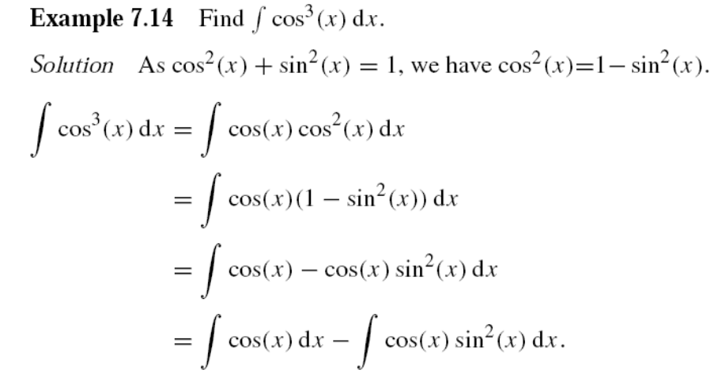
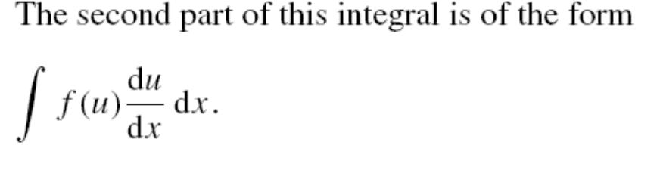
Integration Using Trigonometric Identities
Powers of trigonometric functions can often be integrated by first rewriting them using identities.
Even Powers (e.g., $sin²x$)
Odd Powers (e.g., $cos³x$)
Use double angle formulas to reduce the power.
Use the identity
cos²(x) = 1 - sin²(x) or sin²(x) = 1 - cos²(x)
The second part of this integral is of the product form
so can be solved using substitution.

Slide 9
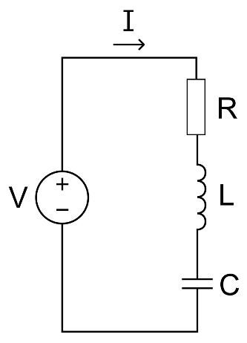
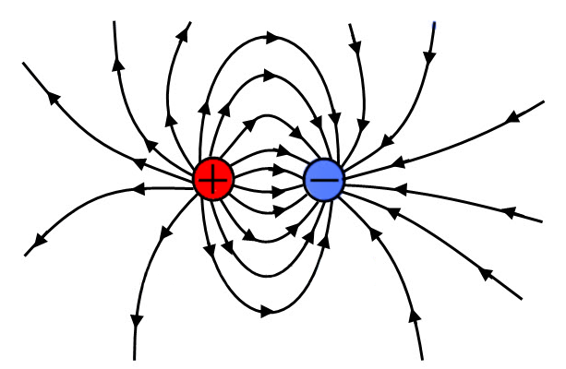

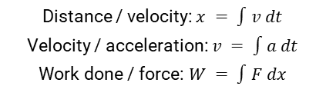
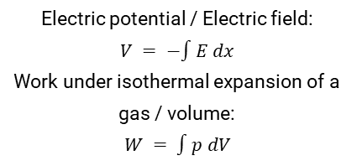
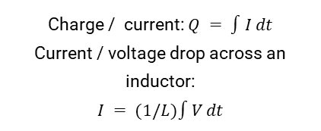
Applications of Integration
Mechanics
Electrical Circuits
Electrostatics & Gases
Distance / velocity: $x = ∫v dt$
Velocity / acceleration: $v = ∫a dt$
Work done / force: $W = ∫F dx$
Charge / current: $Q = ∫I dt$
Current / voltage drop across an inductor:
$$I = (1/L)∫V dt$$
Electric potential / Electric field:
$$V = −∫E dx$$
Work under isothermal expansion of a gas / volume:
$$W = ∫p dV$$

Slide 10
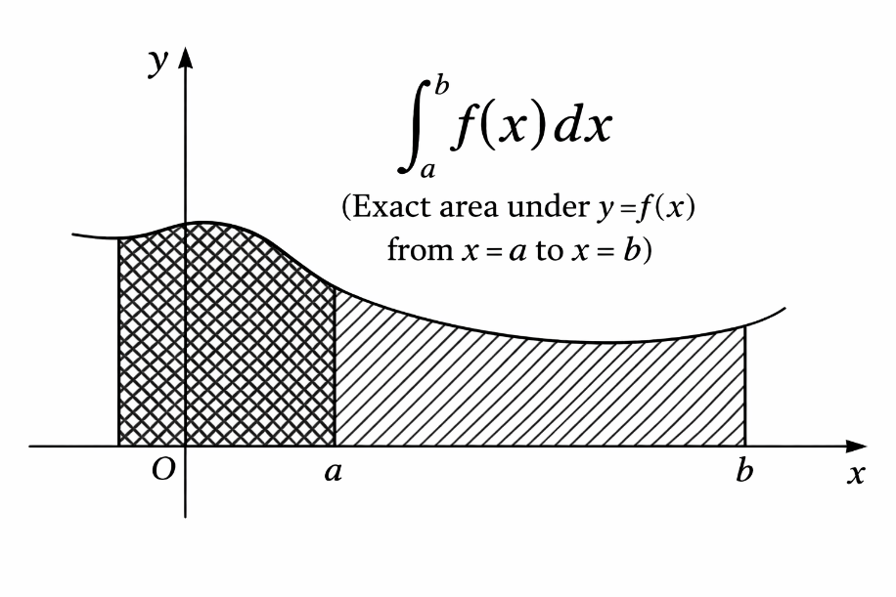
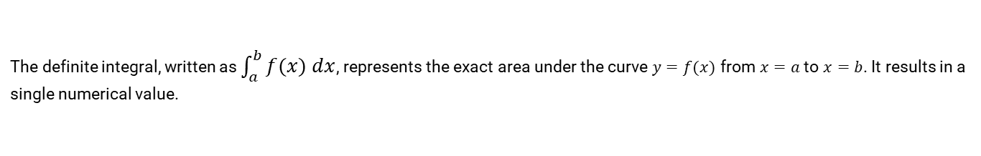
The Definite Integral: Area Under a Curve
The definite integral, written as $\int_{a}^{b}{f(x) dx}$, represents the exact area under the curve $y=f(x)$ from $x=a$ to $x=b$. It results in a single numerical value.
Calculation
Find the indefinite integral, $F(x)$
Evaluate it at the upper limit: $F(b)$
Evaluate it at the lower limit: $F(a)$
Subtract: Area = $F(b) − F(a)$
The constant of integration always cancels out.

Slide 11
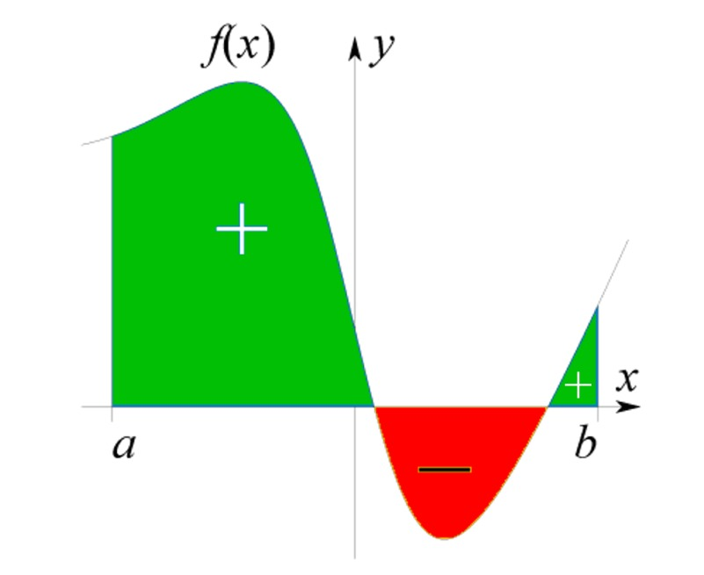
Positive and Negative Areas
The definite integral calculates the *net* area. Areas below the x-axis are counted as negative.
If the curve is below the x-axis, the integral will be negative. The physical area is the absolute value of the integral.
If a curve crosses the x-axis within the integration interval, the positive and negative areas can cancel each other out.
To find the total physical area, you must split the integral at the points where the curve crosses the x-axis and sum the absolute values of each part.

Slide 12
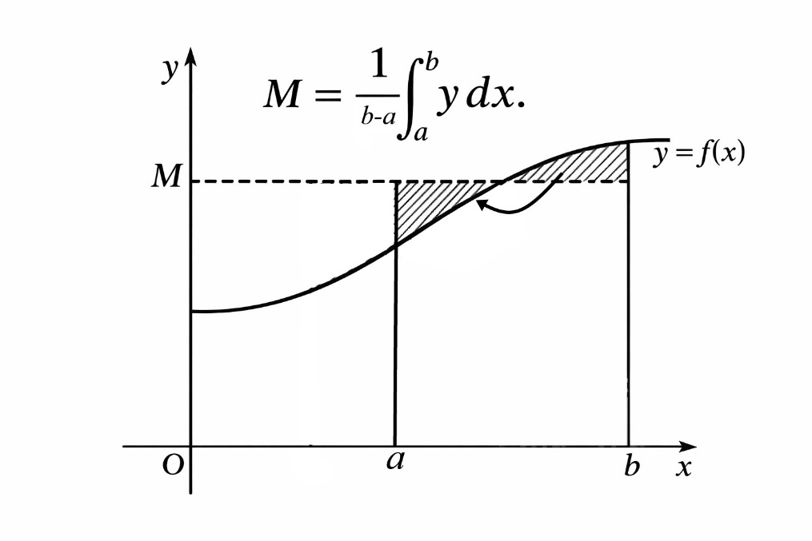
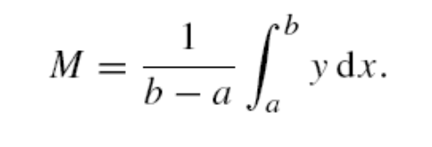
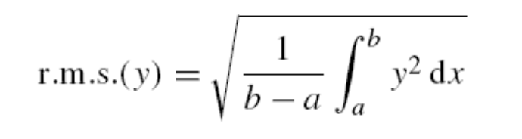
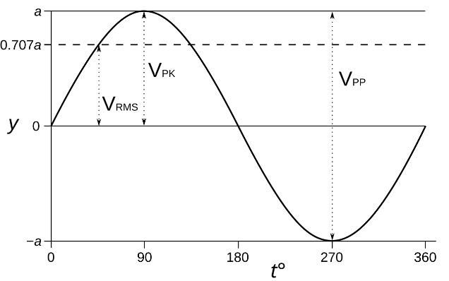
Mean and R.M.S. Values
Mean Value
Root Mean Squared (R.M.S.) Value
The average height of the function over an interval. It's the value a constant function would need to have the same area under its graph.
The square root of the mean of the squared function. It's crucial for AC circuits, as it provides a measure of effective voltage or current that relates to power, and is always positive.

Slide 13
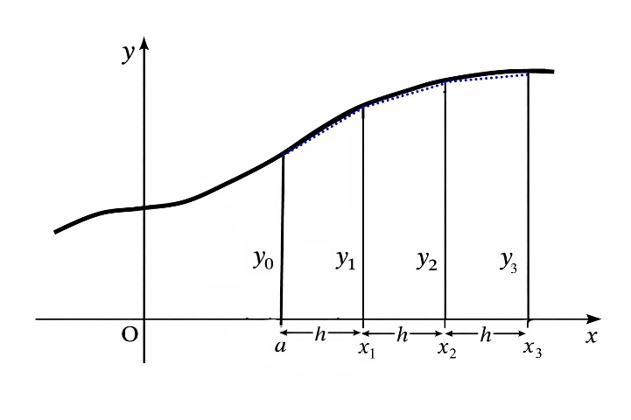
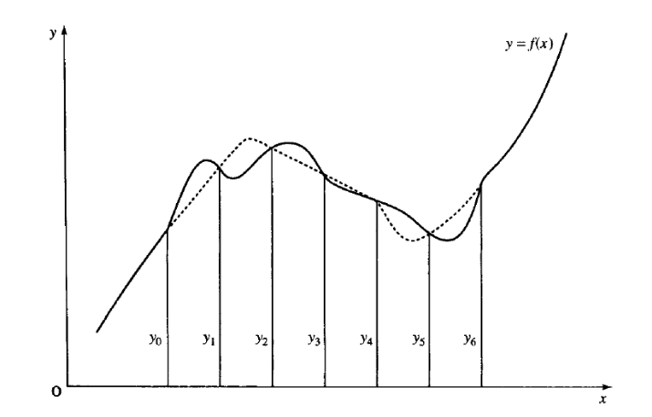
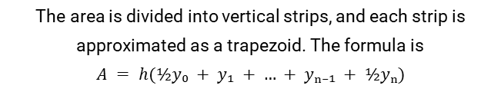
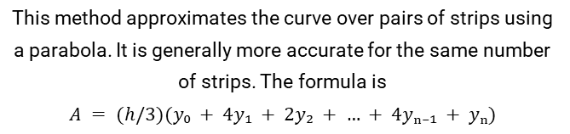
Numerical Integration
When an integral cannot be solved analytically (by formula), we use numerical methods to approximate the area by dividing it into strips.
Trapezoidal Rule
Simpson's Rule
The area is divided into vertical strips, and each strip is approximated as a trapezoid. The formula is
$$A = h(½y₀ + y₁ + … + yₙ₋₁ + ½yₙ)$$
This method approximates the curve over pairs of strips using a parabola. It is generally more accurate for the same number of strips. The formula is
$$A = (h/3)(y₀ + 4y₁ + 2y₂ + … + 4yₙ₋₁ + yₙ)$$

Slide 14
Summary
Integration is the inverse process of differentiation
The indefinite integral has a constant of integration, '$+ C$'. A particular solution is found when '$C$' is determined from known conditions.
Key integration techniques include Substitution, Integration by Parts, and using Trigonometric Identities.
The definite integral calculates a specific numerical value, $F(b) − F(a)$, representing the area under the curve.
Mean and R.M.S. values are used to express the average behaviour of a function.
Trapezoidal and Simpson's rules are two numerical methods used for approximating integrals that cannot be solved analytically.

