Slide 1


Differentiation
Understanding Rates of Change

Slide 2
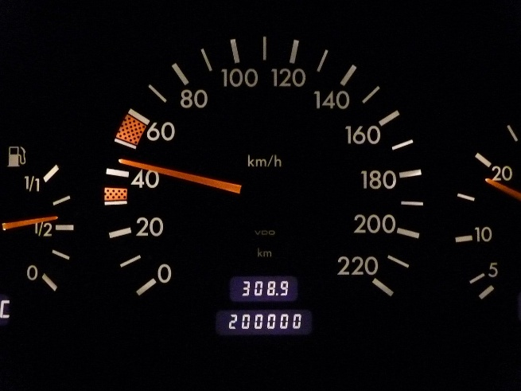
What is Differentiation?
Differentiation is a tool used to find the instantaneous rate of change of one quantity with respect to another. A classic example is speed, which is the rate of change of distance with respect to time. While average speed is calculated as Total Distance / Total Time, differentiation allows us to determine the speed at any specific moment.

Slide 3

From Average to Instantaneous Rate of Change
We can approximate an instantaneous rate by calculating the average rate over a very small interval. For instance, on a long car journey, your average speed might be 40 mph, but your speed varies. Measuring the distance travelled in a tiny 1-second interval gives a very accurate estimate of your speed at that moment.
The average rate of change is the change in a function's value over an interval.
The smaller the interval, the better the approximation to the instantaneous rate.
The instantaneous rate is the limit of the average rate as the interval size approaches zero.

Slide 4
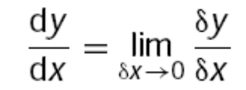
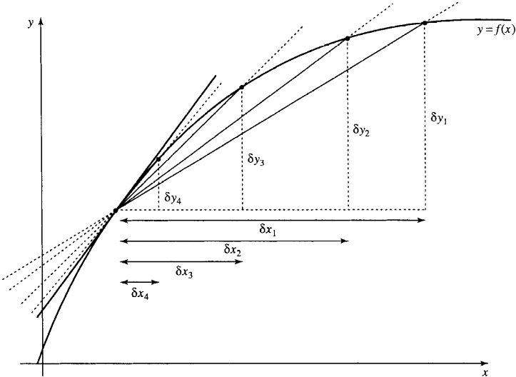
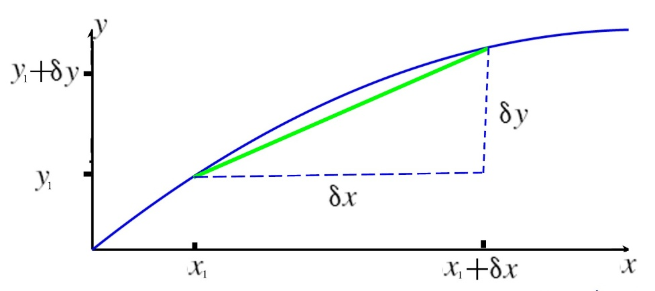
The Gradient and the Derivative
The Chord: Average Rate
The Tangent: Instantaneous Rate
The average rate of change between two points on a graph is the gradient of the line connecting them. This line is called a chord.
As the two points get closer, the chord approaches the tangent—a line that just touches the curve at one point. Its gradient is the derivative.
Gradient of the chord =

Slide 5



Example: Calculating Instantaneous Velocity
A ball's height is given by $s = 20t − 5t²$. Let's estimate its velocity at $t=1$ s by looking at shrinking time intervals.
Time Interval
Change in Time ($δt$)
Change in Distance ($δs$)
Average Velocity ($δs/δt$)
1 to 1.1 s
0.1
0.95
9.5 m/s
1 to 1.01 s
0.01
0.0995
9.95 m/s
1 to 1.001 s
0.001
0.009995
9.995 m/s
As the time interval shrinks, the average velocity clearly approaches a limit of 10 m/s. This is the instantaneous velocity at t=1s.

Slide 6
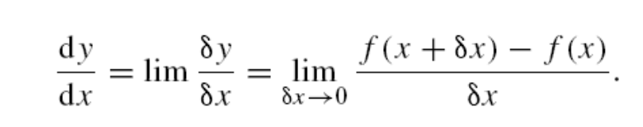
Differentiating from First Principles
The Formal Definition
The process of finding a derivative using the limit definition is called differentiating from first principles.
Example: The Derivative of $y = x²$
Find $f(x+δx)$: $(x+δx)² = x² + 2xδx + (δx)²$
Calculate $δy$: $f(x+δx) − f(x) = 2xδx + (δx)²$
Find the ratio $\frac{δy}{δx}=\frac{2xδx+\left(δx\right)2}{\text{δx}}$
As long as $δx$ does not equal 0 we can divide the top and bottom line of this expression by $δx$ giving $2x + δx$
Take the limit: As $δx$ approaches 0, $(2x + δx)$becomes $2x$.
Result: The derivative of $x²$ is $2x$.

Slide 7



















Common Derivatives
Fortunately, we can use standard rules and known derivatives for most functions without resorting to first principles.
Basic Derivatives
$$f(x)$$
$$f′(x)$$
$$f(x)$$
$$f′(x)$$
Constant ($C$)
$$0$$
$$xⁿ$$
$$nxⁿ⁻¹$$
$\frac{1}{\sqrt{1−x^{2}}}$
$$sin⁡(x)$$
$$cos⁡(x)$$
$$\sin^{−1}(x)⁡$$
$−\frac{1}{\sqrt{1−x^{2}}}$
$$cos⁡(x)$$
$$−sin⁡(x)$$
$$\cos^{−1}(x)⁡$$
$tan⁡(x)$ $\sec^{2}(x) = \frac{1}{\cos^{2}(x)}$
$$\tan^{−1}(x)⁡$$
$\frac{1}{1+x^{2}}$

Slide 8
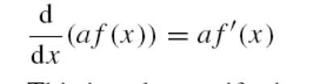
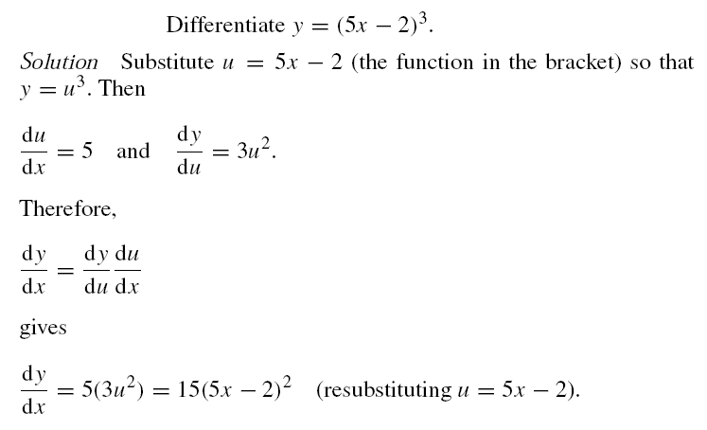
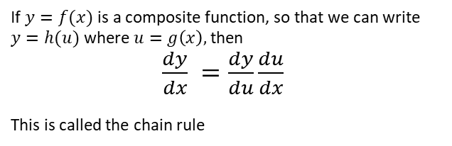

Rules for Differentiating Combinations of Functions
Constant Multiple:
$$\frac{d}{dx}(u ± v) = u′ ± v′$$
Sum/Difference:
Chain Rule
Chain Rule Example
If $y=f(x)$ is a composite function, so that we can write
$y=h(u)$ where $u=g\left(x\right),$ then
$\frac{dy}{dx} =\frac{dy}{du}\frac{du}{dx}$
This is called the chain rule
Quick method: For composite functions like $f(g(x))$. Differentiate the 'outside' function, then multiply by the derivative of the 'inside' function.

Slide 9
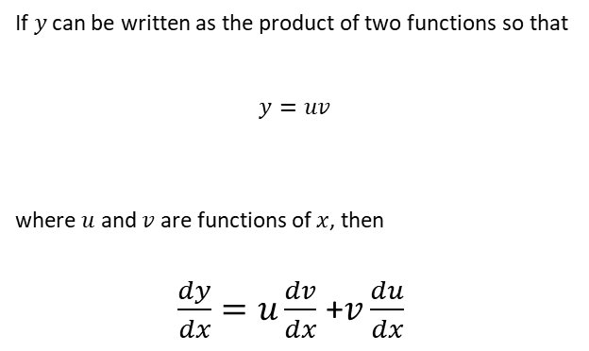
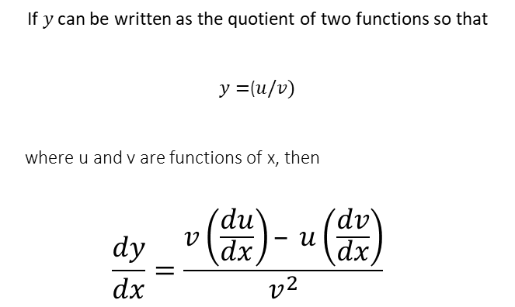
Rules - continued
Product Rule
Quotient Rule
If $y$ can be written as the product of two functions so that
$$y=uv$$
where $u$ and $v$ are functions of $x$, then
$\frac{dy}{dx}=u\frac{dv}{dx}$ +$v\frac{du}{dx}$
If $y$ can be written as the quotient of two functions so that
$y=$($u/v)$
where u and v are functions of x, then
$$\frac{dy}{dx}=\frac{v\left(\frac{du}{dx}\right)– u\left(\frac{dv}{dx}\right)}{v^{2}}$$

Slide 10
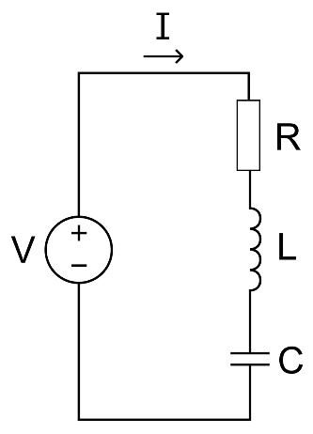

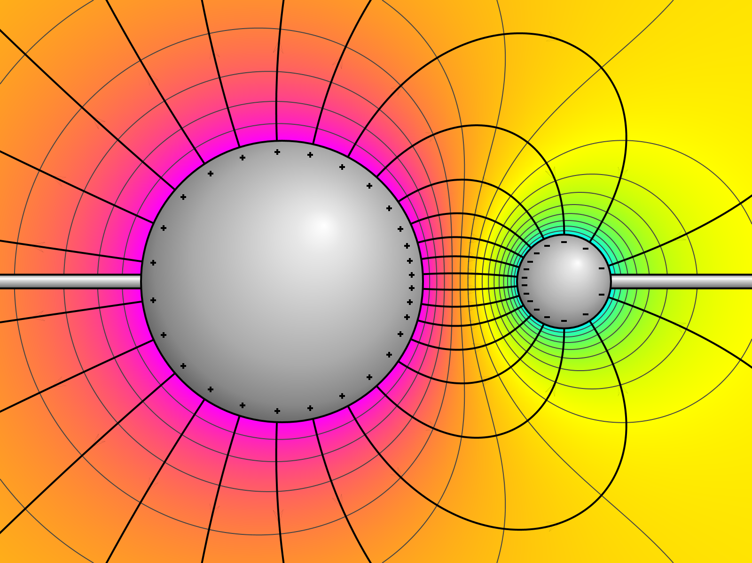
Applications in Engineering & Science
Derivatives are fundamental in describing the physical world. They connect many key concepts in various fields.
Mechanics
Electrical Circuits
Electrostatics
Velocity is the derivative of position. Acceleration is the derivative of velocity. Force can be related to the derivative of momentum or work done.
Electric current is the derivative of charge (rate of flow of charge). The voltage across an inductor is proportional to the derivative of the current.
The electric field strength is the negative derivative of the electric potential, representing the rate of change of potential with distance.
Illustration by By Geek3 - Own work, CC BY-SA 4.0, https://commons.wikimedia.org/w/index.php?curid=90792726

Slide 11
Summary
The derivative gives the instantaneous rate of change.
Geometrically, it's the slope of the graph's tangent line.
It is formally defined as the limit of the average rate of change as the interval shrinks towards zero.
Derivatives of simple functions are given on Slide 7
Standard rules (Sum, Difference, Chain, Product, Quotient) are used to differentiate combinations of functions.
Differentiation is a cornerstone of physics and engineering, linking concepts like position, velocity, and acceleration.

