Slide 1


Trigonometric Functions and Waves

Slide 2

Trigonometric functions and waves.
Introduction
Waves are a fundamental phenomenon in nature, appearing in various forms such as the movement of disturbed water, the passage of sound through air, and the vibrations of a plucked string. When the movement of a particle affected by a wave is plotted against time, it creates a distinct shape called a sinusoid.
The mathematical expression for these waves is found using trigonometric functions, specifically sine and cosine. These functions are key to understanding and describing wave behaviour.

Slide 3
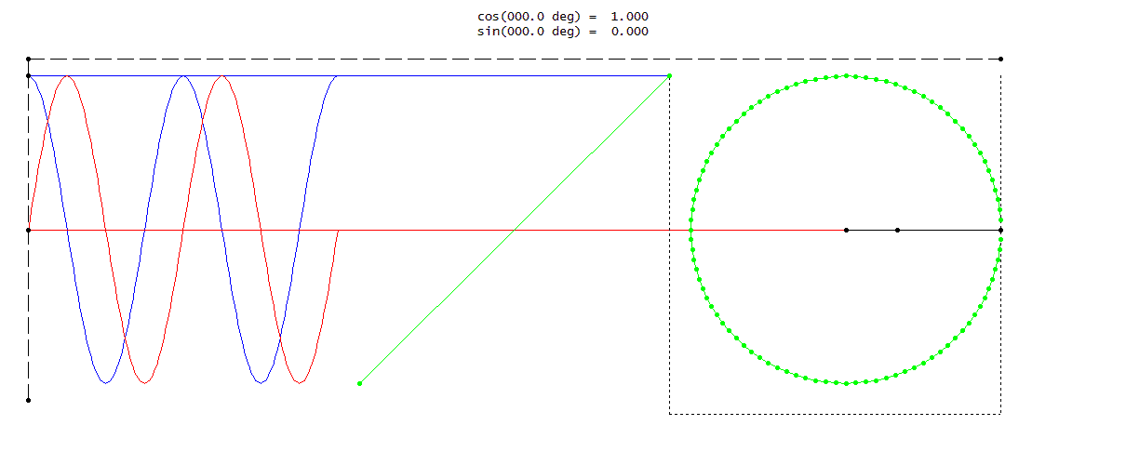
Defining Sine and Cosine with a Rotating Rod
To extend trigonometric functions beyond right-angled triangles, we can use a rotating rod of length 1. As the rod rotates, we track the position of its tip.
Sine Function: $y = sin⁡(t)$
The sine function, sin(t), is defined by plotting the vertical height (y) of the rod's tip against the distance
(t) traveled by the tip.
Cosine Function: $x = cos⁡(t)$
The cosine function, cos(t), is defined by plotting the horizontal position (x) of the rod's tip against the distance
(t) travelled by the tip
Animation by Ohgddfp, CC BY-SA 4.0 <https://creativecommons.org/licenses/by-sa/4.0>, via Wikimedia Commons

Slide 4
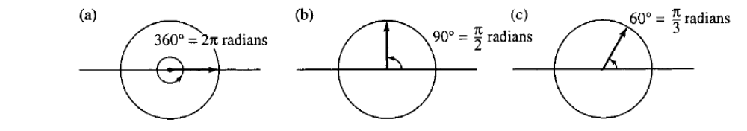
A New Way to Measure Angles: Radians
The trigonometric function definitions become the same as trigonometric ratios in a triangle, for angles up to a right angle, if radians are used as a measure of the angle instead of degrees.
One complete revolution is the circumference of the unit circle, which is $2π$.
Therefore, $360°$ is equivalent to $2π$ radians.
Conversion Formulas
Key Equivalences
To convert degrees to radians, multiply by π/180.
(a) 360° = $2π radians$
To convert radians to degrees, multiply by 180/π.
(b) 90° = $π/2 radians$
(c) 60° = $π/3 radians$

Slide 5
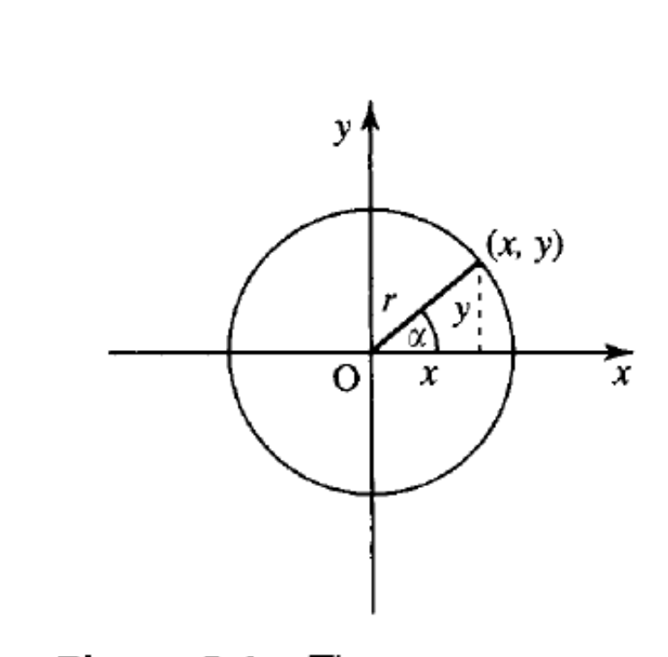

The Pythagorean Identity
Derivation
From the rotating rod diagram, the coordinates $(x, y)$ and radius r form a right-angled triangle.
By Pythagoras's theorem: $x² + y² = r²$
Divide by $r²: (x/r)² + (y/r)² = 1$
Since $cos⁡(α) = x/r$and $sin⁡(α) = y/r$, we substitute these in the above.
This gives the identity: $(cos⁡(α))² + (sin⁡(α))² = 1$
which is written in shorthand as: $cos²(α) + sin²(α) = 1$

Slide 6
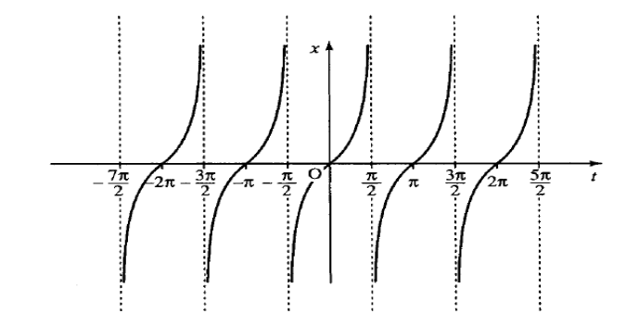
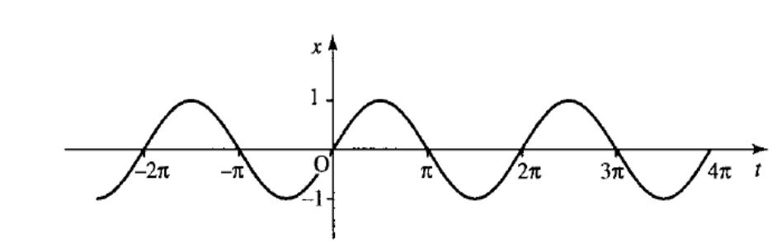
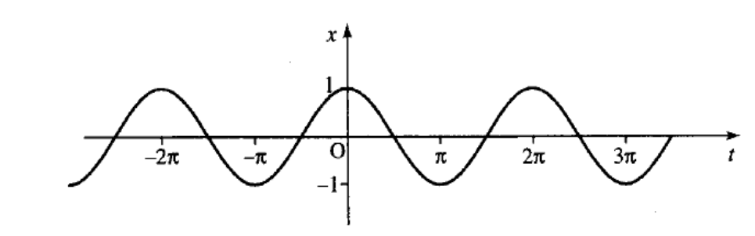











Graphs and Properties of Trigonometric Functions
$$y = sin⁡(t)$$
$$x = cos⁡(t)$$
$$z = tan⁡(t)$$
Periodic with period $2π$
Periodic with period $2π$
Periodic with period $π$
Range: $[−1, 1]$
Range: $[−1, 1]$
Range: All real numbers
Odd function: $sin⁡(−t) = −sin⁡(t)$
Even function: $cos⁡(−t) = cos⁡(t)$
Odd function: $tan⁡(−t) = −tan⁡(t)$

Slide 7
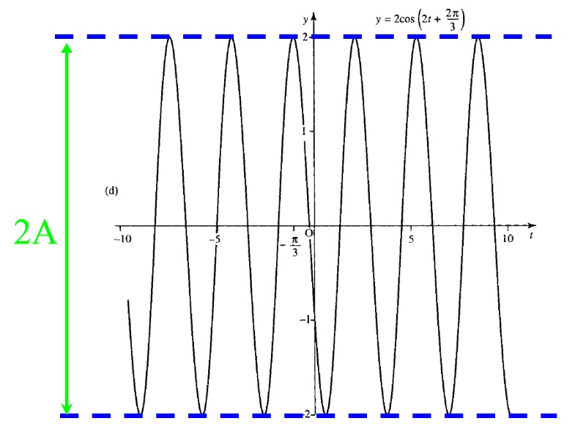
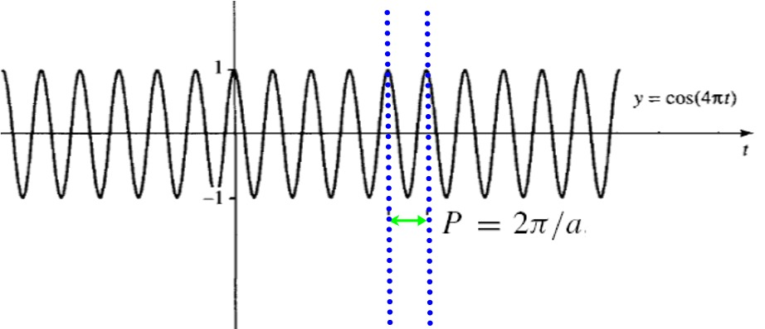

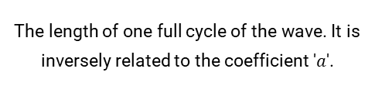


The General Sinusoidal Function
$$y = A cos⁡(ax + b) + B$$
We can transform the basic cosine function to model any sinusoidal wave in one variable. Each parameter has a specific effect on the graph.
Amplitude ($A$)
Fundamental Period ($2π/a$)
Determines the maximum displacement or height of the wave. It's half the distance between the peak and the trough.
The length of one full cycle of the wave. It is inversely related to the coefficient '$a$'.

Slide 8
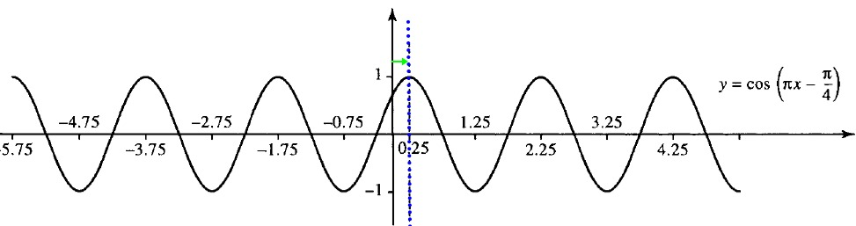
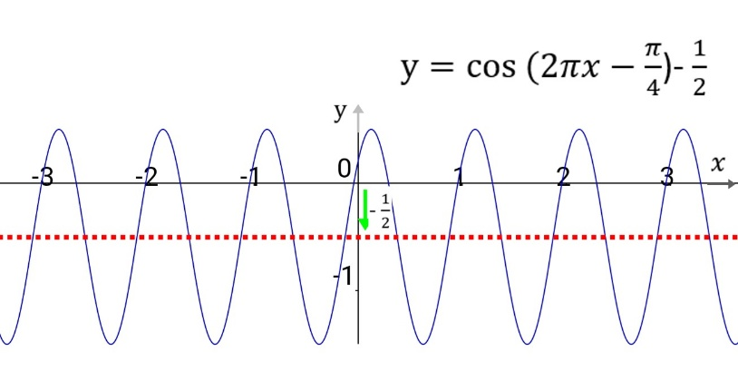
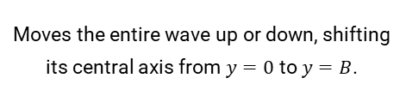

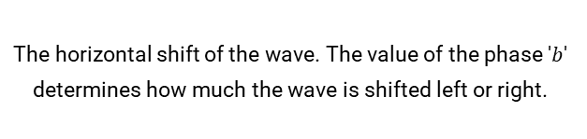

$y = A cos⁡(ax + b) + B$ (continued)
Phase Shift ($−b/a$)
Vertical Shift ($B$)
The horizontal shift of the wave. The value of the phase '$b$' determines how much the wave is shifted left or right.
Moves the entire wave up or down, shifting its central axis from $y=0$ to $y=B$.

Slide 9


Waves in Time vs. Waves in Space
Functions of Time
Functions of Distance
$$y = A cos⁡(ωt + φ)$$
$$y = A cos⁡(kx + φ)$$
Describes displacement at a fixed point over time (e.g., a boat bobbing up and down).
A snapshot of the wave's displacement over a distance at a fixed moment in time.
$A$: Amplitude
$A$: Amplitude
$ω$: Angular Frequency ($rad/s$)
$k$: Wavenumber
f = ω/2π: Frequency ($Hz$)
Spatial Frequency = $k/2π$
$τ = 1/f$: Period ($s$)
$λ = 2π/k$: Wavelength ($m$)
$φ$: Phase
$φ$: Phase

Slide 10
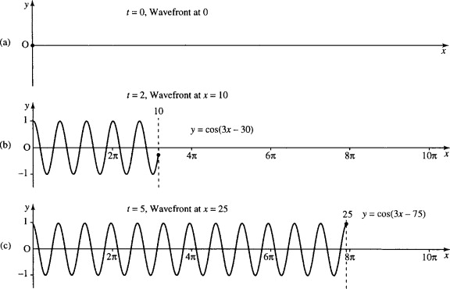

The Progressive Wave Equation
By combining the functions of time and space, we get the progressive wave equation.
$$y = A cos⁡(ωt − kx)$$
Where k is positive, this describes a wave travelling from left to right. The velocity (v) of this wave is the product of its frequency (f) and wavelength (λ).
$v = fλ$
Since $f = ω/2π$and $λ = 2π/k$, the velocity can also be written as:
$v = ω/k$
Three snapshot pictures of the progressive wave
y = cos(15t − 3x) at t = 0, t = 2, and t = 5.

Slide 11

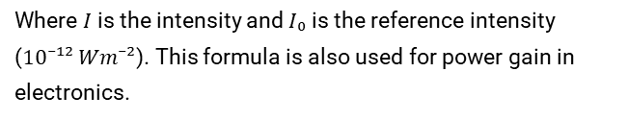


Measuring Amplitudes: Decibels (dB)
Because wave amplitudes can span a huge range of values, a logarithmic scale called the decibel (dB) is often used. It measures a level relative to a reference value.
Sound Pressure Level (SPL)
Sound Intensity / Power Gain
$$SPL (dB) = 20 log₁₀(p / p₀)$$
$$Level (dB) = 10 log₁₀(I / I₀)$$
Where $p$ is the sound pressure and $p₀$ is the reference pressure ($2 x 10⁻⁵ Nm⁻²$), the threshold of human hearing.
Where $I$ is the intensity and $I₀$ is the reference intensity ($10⁻¹² Wm⁻²$). This formula is also used for power gain in electronics.

Slide 12
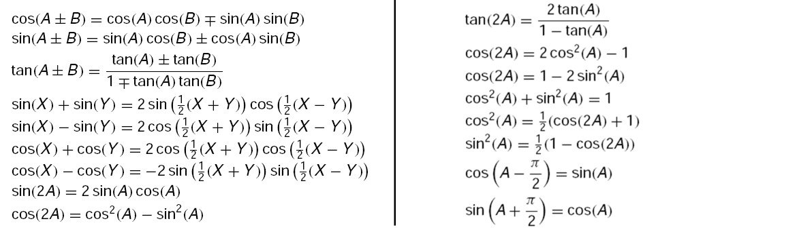
Trigonometric Identities
A common mistake: $cos⁡(A + B)$is NOT $cos⁡(A) + cos⁡(B)$!
Trigonometric identities are expressions that are true for all values of the variables. They are essential for simplifying expressions and solving equations involving waves.

Slide 13
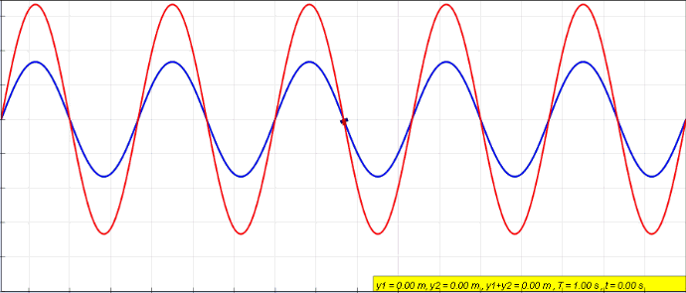
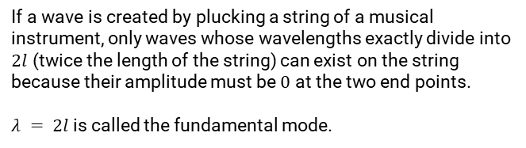
Superposition and Standing Waves
Principle of Superposition
The principle of superposition states that when two or more waves overlap, the resulting disturbance is the algebraic sum of the individual disturbances.
Standing Waves
A standing wave is formed when a wave reflects back on itself, interfering with the original incident wave. This creates points of zero amplitude (nodes) and maximum amplitude (antinodes).
Animation of a standing wave (red) created by the superposition of a left travelling (blue) and right travelling (green) wave.
Image by Lookangmany thanks to author of original simulation = Wolfgang Christian and Francisco Esquembre author of Easy Java Simulation = Francisco Esquembre, CC BY-SA 4.0, via Wikimedia Commons
If a wave is created by plucking a string of a musical instrument, only waves whose wavelengths exactly divide into $2l$ (twice the length of the string) can exist on the string because their amplitude must be $0$ at the two end points.
$λ = 2l$is called the fundamental mode.

Slide 14
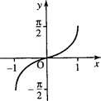
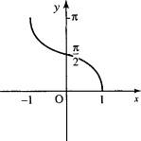
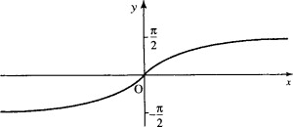






Inverse Trigonometric Functions
To define an inverse for a trigonometric function, we must restrict its domain to a range where it is one-to-one. The inverse function 'undoes' the original function.
$$arcsin⁡(x) or sin⁻¹(x)$$
$$arccos⁡(x) or cos⁻¹(x)$$
$$arctan⁡(x) or tan⁻¹(x)$$
Inverse of $sin⁡(x)$ for $x$ in $[−π/2, π/2].$
Inverse of $cos⁡(x)$ for $x$ in $[0, π]$.
Inverse of $tan⁡(x)$ for $x$ in $(−π/2, π/2)$.

Slide 15
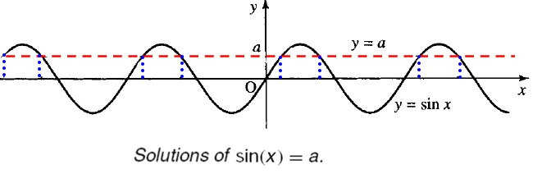
Solving Trigonometric Equations
To find all solutions, we first use the inverse function to find the principal solution, then use the periodic nature of the function to find all other solutions.
For $sin⁡(x) = a$, the solutions in one cycle are $x = sin⁻¹(a)$and $x = π − sin⁻¹(a)$. Add multiples of $2π$ for all solutions.
For $cos⁡(x) = a$, the solutions in one cycle are $x = cos⁻¹(a)$and $x = −cos⁻¹(a)$. Add multiples of $2π$ for all solutions.
For $tan⁡(x) = a$, the solution in one cycle is $x = tan⁻¹(a)$. Add multiples of $π$ for all solutions.

Slide 16
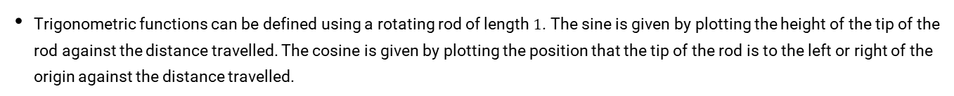
Summary
Trigonometric functions can be defined using a rotating rod of length $1$. The sine is given by plotting the height of the tip of the rod against the distance travelled. The cosine is given by plotting the position that the tip of the rod is to the left or right of the origin against the distance travelled.
Radians are used for trigonometric functions, with $2π radians$= 360°.
$sin⁡(t)$ and $tan⁡(t)$ are odd functions, while $cos⁡(t)$ is an even function.
Wave amplitudes are often measured on a logarithmic scale using decibels.
There are many trigonometric identities, like $cos²(A) + sin²(A) = 1$and sum/difference formulas.
The general wave function $y = A cos⁡(ax + b)$has amplitude $A$, period $2π/a$, and phase $b$.
Progressive waves, $y = A cos⁡(ωt − kx)$, describe waves moving in time and space with velocity $v = ω/k$.
The superposition principle explains how waves combine, leading to phenomena like standing waves.
Inverse trigonometric functions ($arcsin⁡$, $arccos⁡$, $arctan⁡$) are used in solving trigonometric equations.

