Slide 1

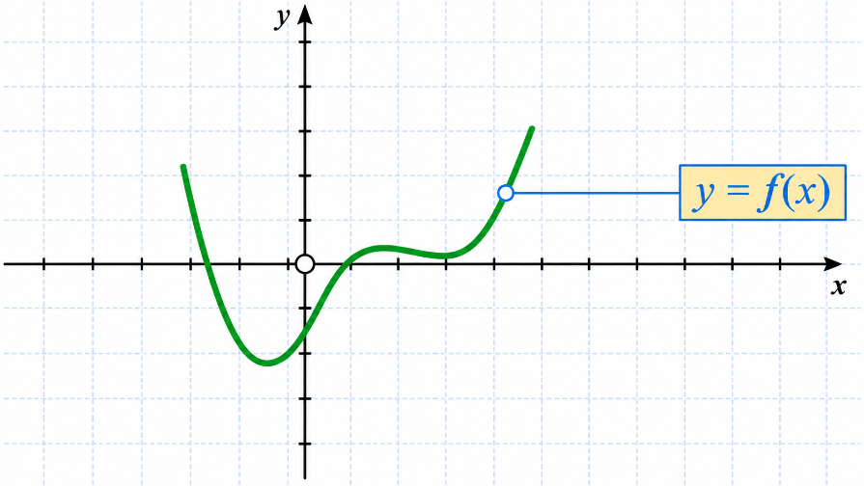
Functions and their graphs

Slide 2
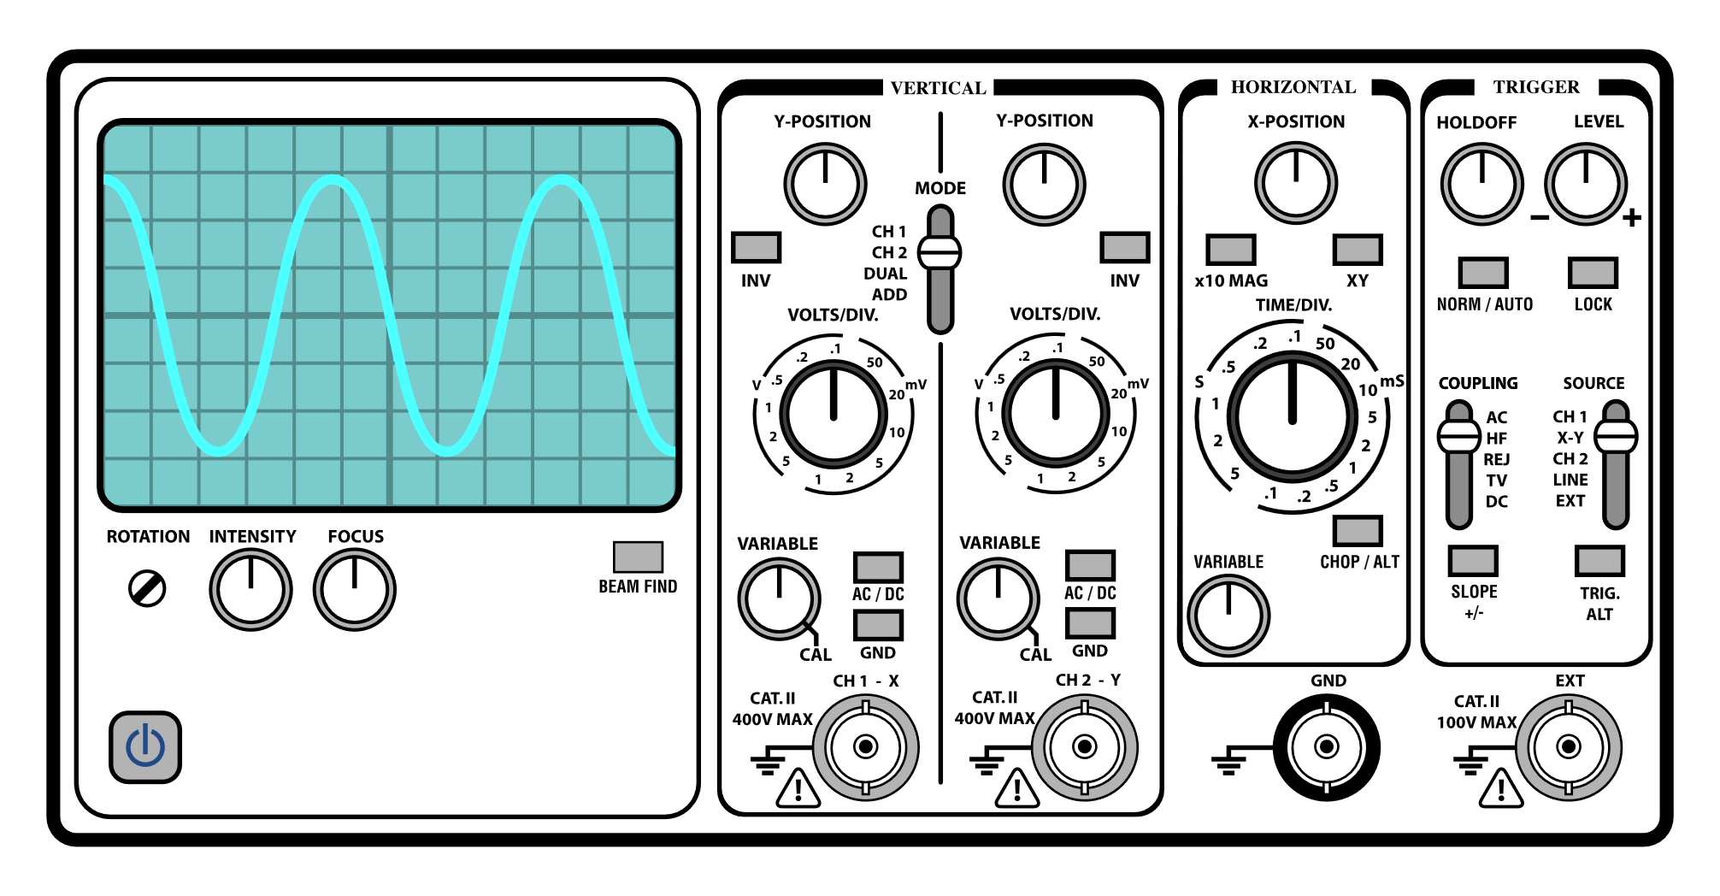
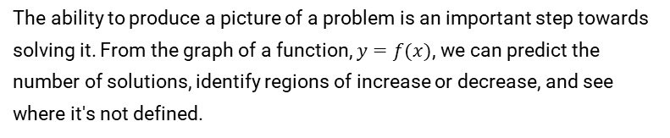
Introduction: Why Graphs Matter
The ability to produce a picture of a problem is an important step towards solving it. From the graph of a function, $y=f(x)$, we can predict the number of solutions, identify regions of increase or decrease, and see where it's not defined.
Recognizing the shape of functions is a crucial skill.
Oscilloscopes use graphs to represent voltage over time.
By knowing a few key graphs and simple transformations, we can sketch a wide variety of functions.

Slide 3
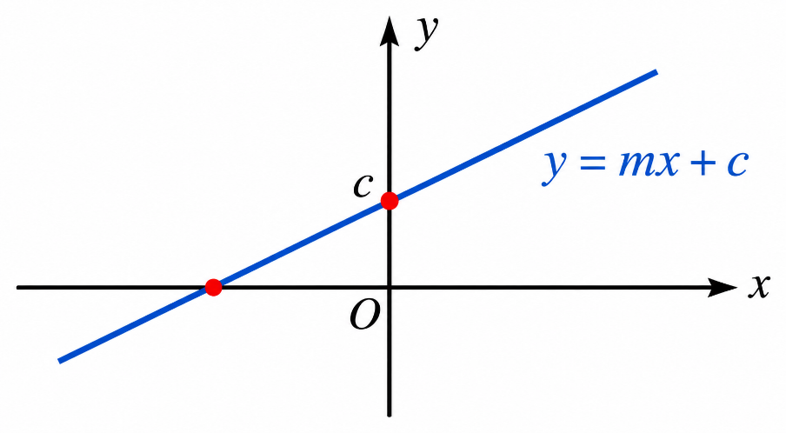


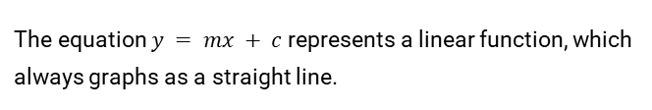
The Straight Line: $y = mx + c$
Anatomy of a Linear Function
The equation $y = mx + c$represents a linear function, which always graphs as a straight line.
$m$: The gradient or slope of the line.
$c$: The value of $y$ where the line crosses the $y$-axis (when $x=0$).

Slide 4
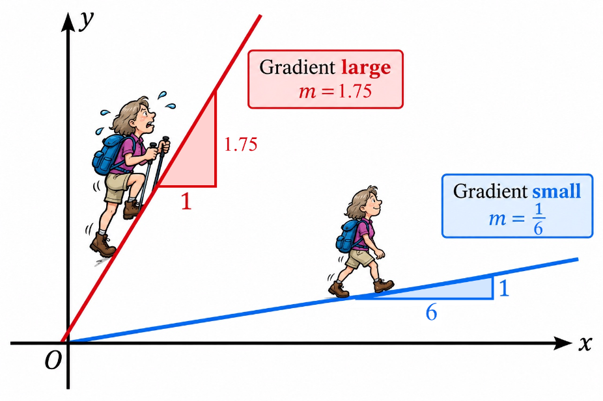
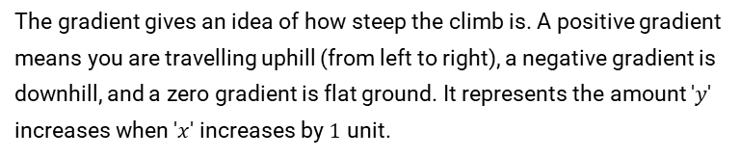
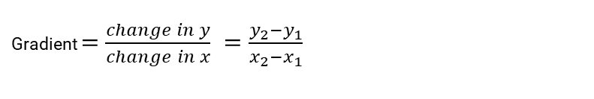

Understanding the Gradient
The gradient gives an idea of how steep the climb is. A positive gradient means you are travelling uphill (from left to right), a negative gradient is downhill, and a zero gradient is flat ground. It represents the amount '$y$' increases when '$x$' increases by $1$ unit.
Calculating the Gradient
To find the gradient of a line, given any two points on the line $(x₁, y₁)$and $(x₂, y₂)$, the formula is:
Gradient $=$ $\frac{change in y}{change in x} =\frac{y_{2}−y_{1}}{x_{2}−x_{1}}$

Slide 5
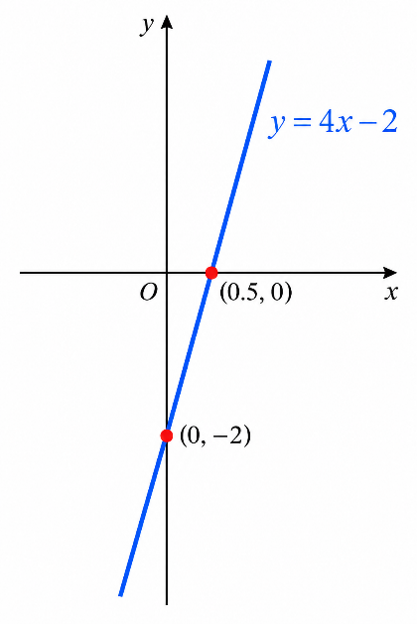


Sketching a Straight Line
Find two points on the line
Example: $y = 4x − 2$
Substitute $x=0$ into the equation to find the point $(0, y)$.
If $x=0, y = −2$. Point is $(0, −2)$.
If $y=0$, $4x−2=0$, so $x = 0.5$. Point is $(0.5, 0)$.
Substitute $y=0$ into the equation and solve for $x$ to find the point $(x, 0)$.
Join $(0,−2)$and $(0.5, 0)$.
Mark these two points on your graph and join them with a straight line.
However, any two points on the graph can be used and sometimes it is more convenient to find other points.

Slide 6
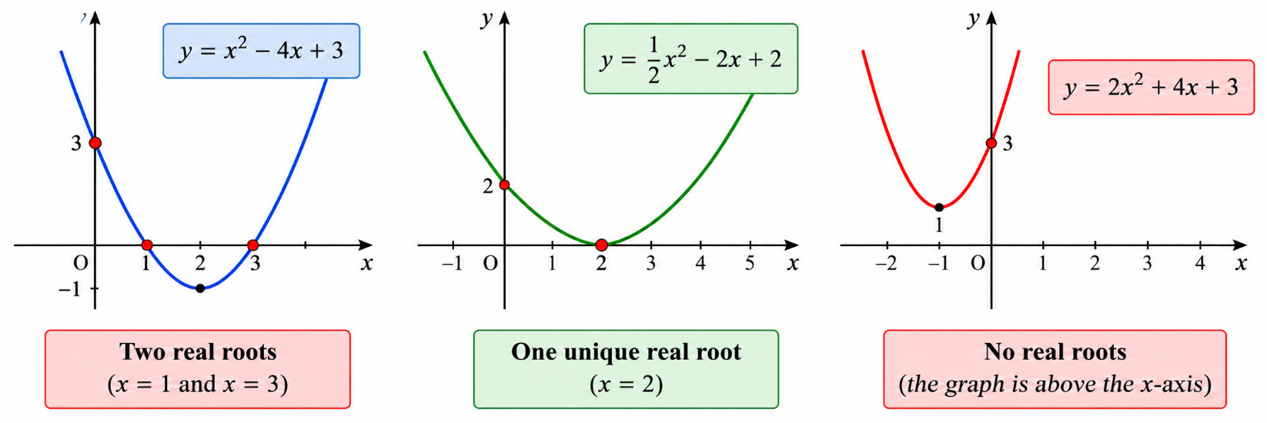

The Quadratic Function: $y = ax² + bx + c$
The graph of the quadratic function is a parabola. The values of x where the graph crosses the x-axis (where y=0) are called the roots.
$\text{The} \text{roots} \text{of} \text{a} \text{quadratic} \text{equation} ax^{2}+ bx + c=0 \text{are} \text{given} \text{by} \text{:}$
$$x \text{= }\frac{ −b ±\sqrt{b^{2}−4ac}}{2a}$$
The term $b^{2}− 4ac$tells us how many real roots the equation has.
Two Real Roots
One Unique Root
No Real Roots
b² - 4ac > 0. The graph crosses the x-axis in two distinct places.
b² - 4ac = 0. The graph touches the x-axis at a single point (its vertex).
b² - 4ac < 0. The graph does not cross or touch the x-axis at all.

Slide 7
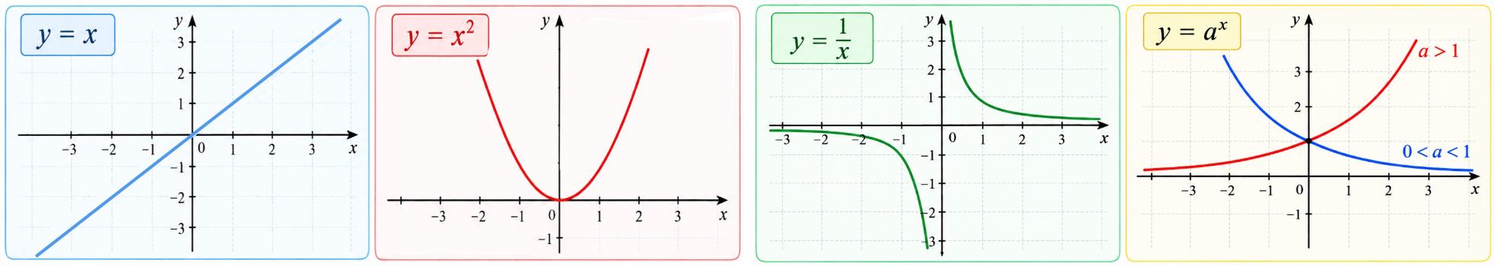

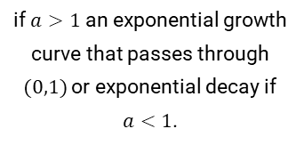




A Library of Basic Graphs
Memorizing these simple function shapes is the key to sketching more complex graphs.
$$y = x$$
$$y = x²$$
$y =\frac{1}{x}$
$$y = aˣ$$
A straight line passing through the origin with a gradient of 1.
A U-shaped parabola with its vertex at the origin.
A hyperbola with two curves in opposite quadrants, never touching the axes.
if $a>1$ an exponential growth curve that passes through $(0,1)$or exponential decay if $a<1$.

Slide 8
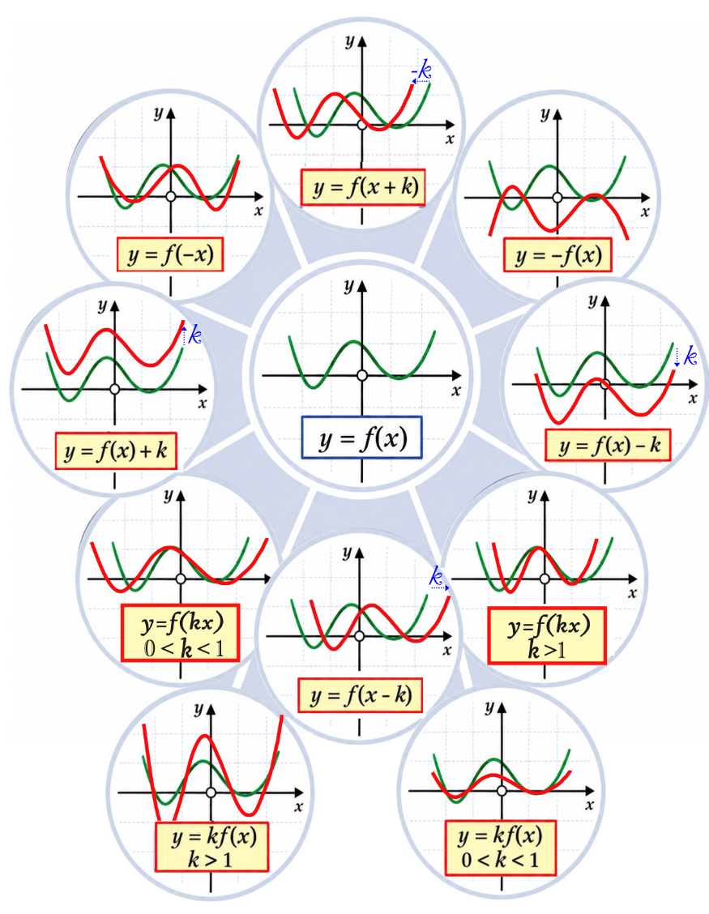
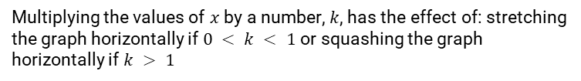


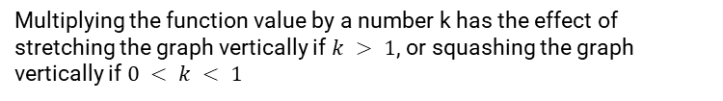
Graph Transformations
Horizontal Shift: $y = f(x+k)$/ $y=f(x−k)$
Replacing '$x$' with ‘$x+k$’ or ‘$x−k$’ translates the graph to the left or to the right.
Reflection in $y$-axis: $y = f(−x)$
Replacing 'x' with '-x' reflects the graph across the y-axis, as if placing a mirror on it.
Reflection in $x$-axis: $y = −f(x)$
Multiplying the entire function by $−1$ reflects the graph across the x-axis, turning it upside down.
Vertical Shift : $y = f(x) + k$/ $y=f(x)−k$
Adding or subtracting a constant to the whole function moves the entire graph upwards or downwards
Stretching or squashing horizontally : $y = f(kx)$
Multiplying the values of $x$ by a number, $k$, has the effect of: stretching the graph horizontally if $0 < k < 1$or squashing the graph horizontally if $k > 1$
Stretching or squashing vertically : $y = kf(x)$
Multiplying the function value by a number k has the effect of stretching the graph vertically if $k > 1$, or squashing the graph vertically if $0 < k < 1$

Slide 9
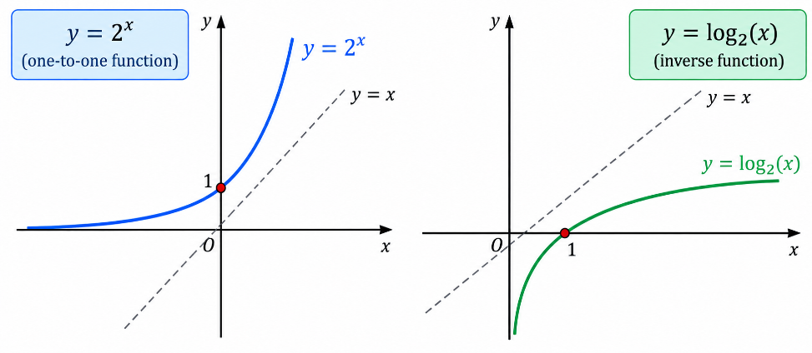
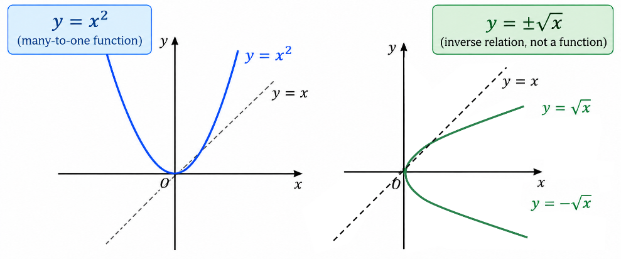


Inverse Functions
Reflecting a function's graph in the line $y=x$ gives the graph of its inverse relation. Only 'one-to-one' functions, where each $y$-value corresponds to exactly one $x$-value, have an inverse function.
One-to-One Function
Many-to-One Function
The function $y = 2ˣ$is one-to-one. Its inverse,, $y = log₂(x)$ is also a function.
The function $y = x²$is many-to-one (e.g., $y=4$ for both $x=2$ and $x=−2$). Its inverse, $y = ±√x$, is not a function.
The composition of a function with its inverse is

Slide 10
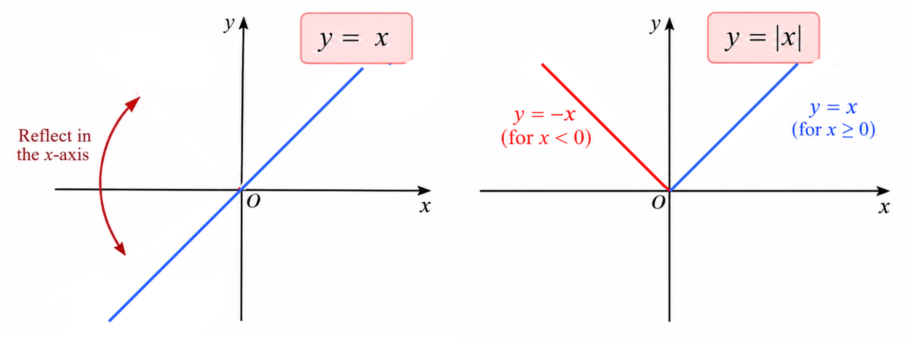
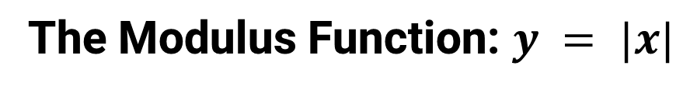
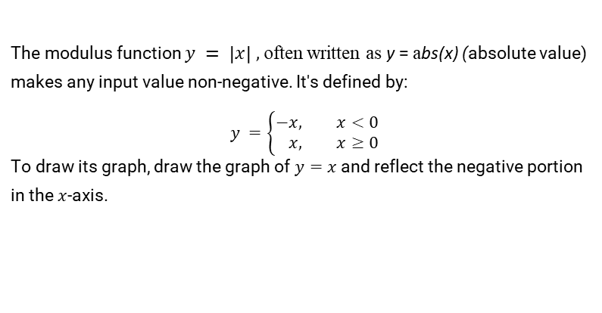
The Modulus Function: $y = |x|$
The modulus function $y = \left|x\right| ,$often written as y = abs(x) (absolute value) makes any input value non-negative. It's defined by:
$$y =\left\{\begin{aligned}−&x, x<0 \\ &x, x≥0\end{aligned}\right.$$
To draw its graph, draw the graph of $y=x$and reflect the negative portion in the $x$-axis.

Slide 11
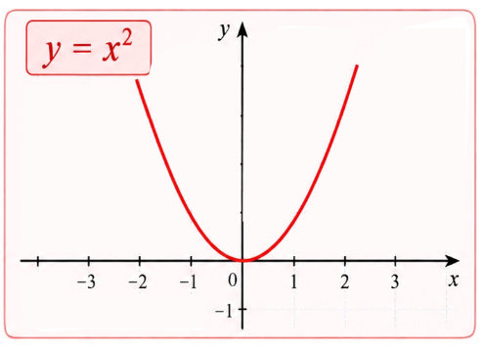
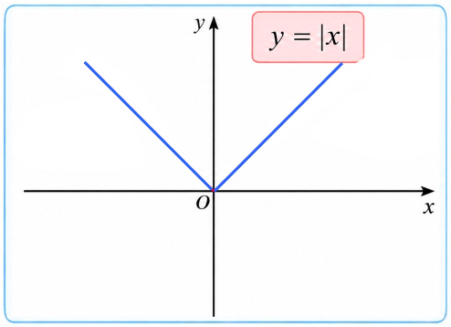
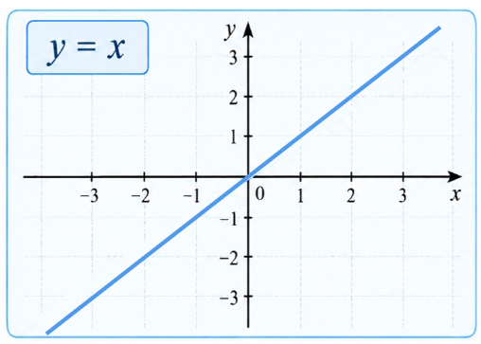
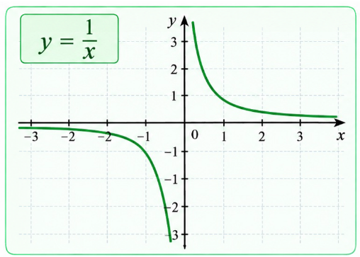

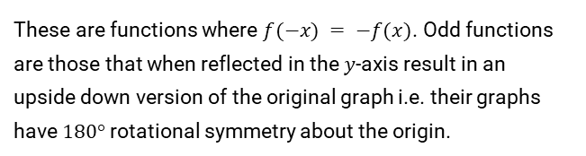
Symmetry of Functions
Even Functions
Odd Functions
These are functions where $f(x) = f(−x)$. Their graphs are symmetrical about the $y$-axis.
These are functions where $f(−x) = −f(x)$. Odd functions are those that when reflected in the $y$-axis result in an
upside down version of the original graph i.e. their graphs have $180°$ rotational symmetry about the origin.
Example: $y = x²$
Example: $y = |x|$
Example: $y = x$
Example: $y =\frac{1}{x}$

Slide 12
Solving Inequalities
The Golden Rule
You can solve inequalities much like equations (adding, subtracting, multiplying, dividing on both sides using the same non-zero expression). However, there is one crucial exception: if you multiply or divide both sides by a negative number or expression, you must reverse the direction of the inequality sign.
Example: $3 < 5$
Multiply by $−1$ and reverse the inequality sign: $\left(−1\right).3 > \left(−1\right).5$
Result: $−3 > −5$ which is true

Slide 13
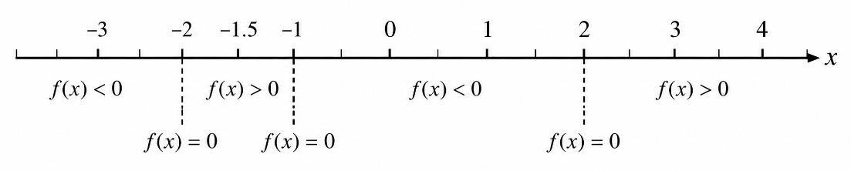

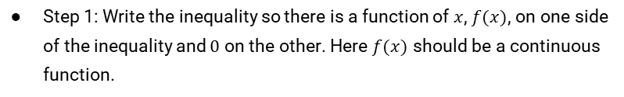
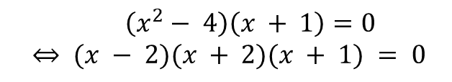



Solving More Difficult Inequalities
To solve a more difficult inequality:
Example
Step 1: Write the inequality so there is a function of $x$, $f(x)$, on one side of the inequality and $0$ on the other. Here $f(x)$ should be a continuous function.
Solving $(x^{2}− 4)(x + 1) > 0$
Step 2: Solve the equation $f(x) = 0$.
$$\left(x^{2}− 4\right)\left(x + 1\right)=0$$
$$⇔ (x − 2)(x + 2)(x + 1) = 0$$
Step 3: Mark the roots on a number line. This divides the line into intervals.
$$⇔ x = 2, x = −2, or x = −1$$
Step 4: Pick a test value from each interval and substitute it into $f(x)$ to see if the result is positive or negative.
Step 5: Identify the intervals that satisfy the original inequality.
Looking for the regions where $f (x) > 0$
gives the solution as $−2 < x < −1 or x > 2$

Slide 14
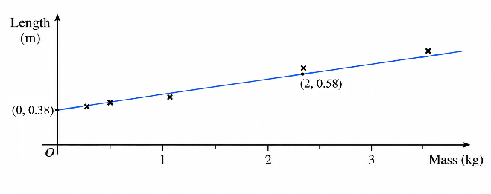
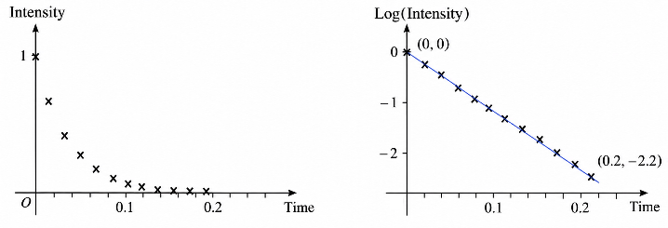
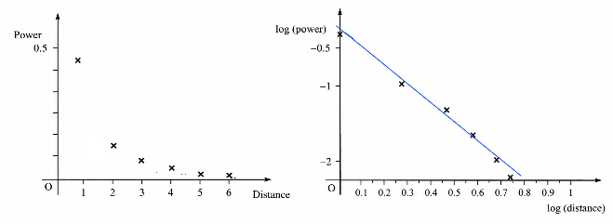

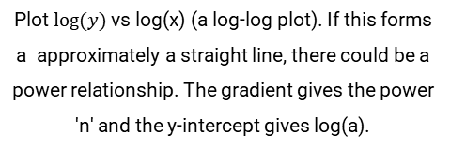

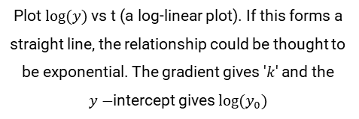

Finding Functions from Experimental Data
Graphs are essential tools for identifying mathematical relationships from experimental data. By plotting the data in different ways, we can uncover underlying linear, exponential, or power-law trends.
Linear Relationship ($y = mx + c$)
Exponential Relationship ($y =y_{0}10ᵏᵗ$)
Power Relationship ($y = axⁿ$)
Plot y vs x. If the points form approximately a straight line, the relationship could be thought to be linear. The gradient (m) and y-intercept (c) can be found directly from the line of best fit.
Plot $log⁡(y)$ vs t (a log-linear plot). If this forms a straight line, the relationship could be thought to be exponential. The gradient gives '$k$' and the
$y−$intercept gives $log⁡(y_{0})$
Plot $log⁡(y)$ vs log(x) (a log-log plot). If this forms a approximately a straight line, there could be a power relationship. The gradient gives the power 'n' and the y-intercept gives log(a).

Slide 15
Summary
Linear Function ($y=mx+c$): '$m$' is the gradient, '$c$' is the y-intercept.
Quadratic Function ($y=ax²+bx+c$): A parabola whose number of roots are determined by evaluating $b²−4ac$.
Graph Transformations: Common graphs can be found by shifting, reflecting, and scaling from a few basic shapes.
Symmetry: Functions with symmetry can be classified as even (reflecting in the y-axis gives an identical graph): $f \left(−x\right)= f \left(x\right),$or odd (reflecting in the $y−$axis turns the graph upside-down): $f \left(−x\right)=−f \left(x\right)$.
Inverse Functions: Only exist for one-to-one functions and their graphs can be found by reflecting in $y=x.$The inverse function takes any image back to its original value
Inequalities: Solved like equations, but reverse the sign when multiplying/dividing by a negative quantity. More complex inequalities: $f(x) > 0$, $f (x) < 0$, $f≤ 0$, or $f \left(x\right)≥ 0$, where f (x) is a continuous function, can be solved by marking the roots of the function f(x)=0 on a number line to determine regions which satisfy the associated inequality.
Data Analysis: Linear, log-linear, and log-log plots help identify relationships in data, i.e. linear, exponential and power relationships.

