Slide 1

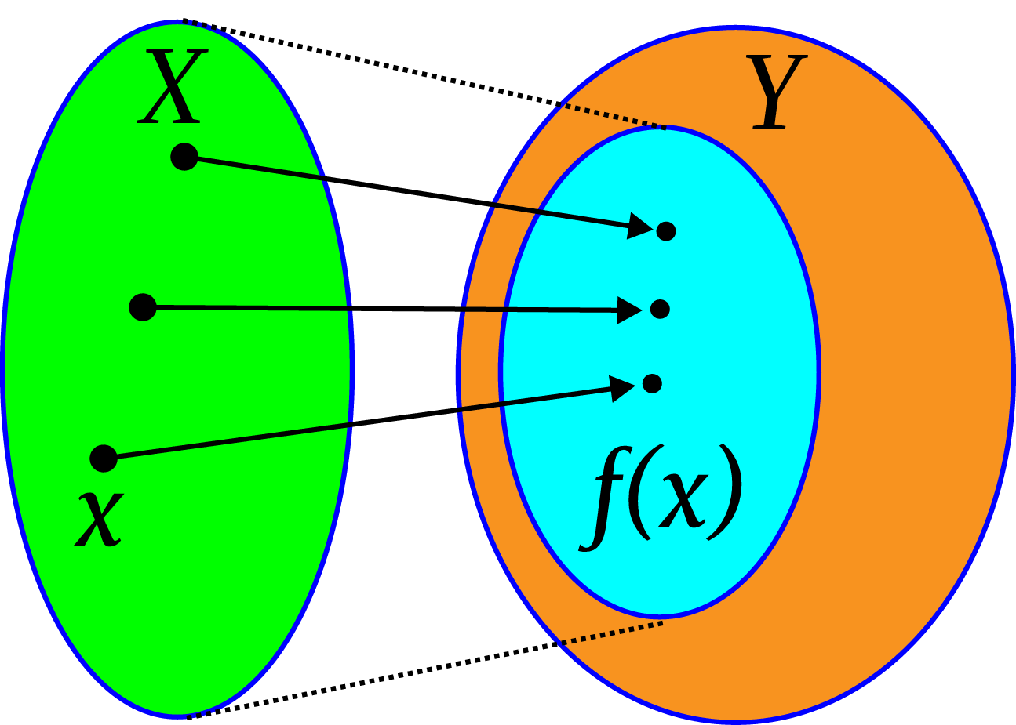
Sets and functions

Slide 2
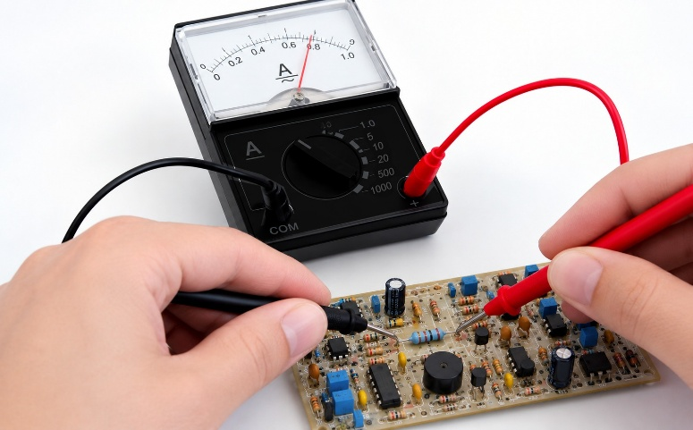
1.1 Introduction: Functions in Engineering
Finding relationships between quantities is central to engineering. For instance, in a simple circuit with a 1000 Ω resistor, Ohm's law gives the relationship between current (I) and voltage (V) as I = V / 1000. For any value of V, we can find a corresponding value of I. I is a function of V.

Slide 3


Functions
This simple idea raises further questions:
Are all values of V permitted? Extremely high voltages might alter the resistor's properties.
How do we combine functions if V itself is a function of other network voltages?
Can we find an inverse function that defines how voltage depends on the current? (e.g., from $I=V/1000$to $V=1000I$).

Slide 4
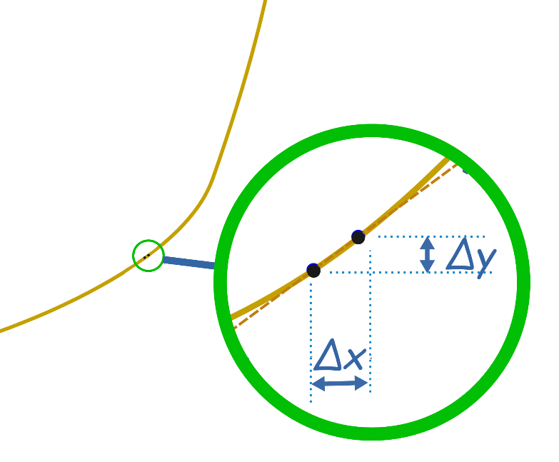
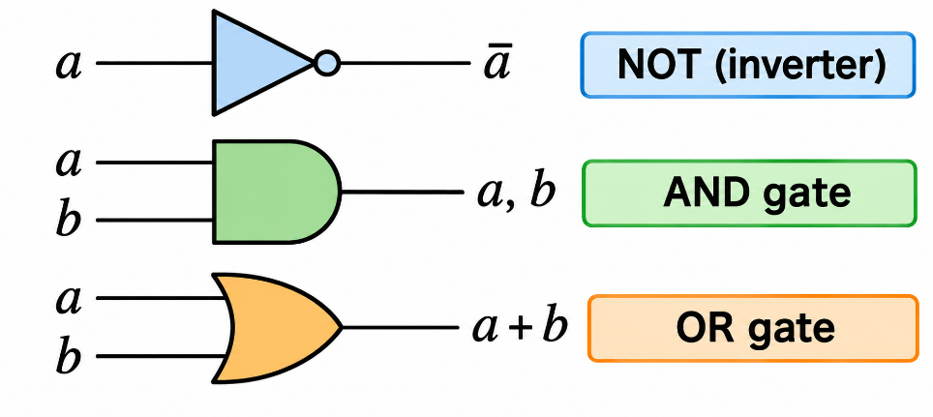
Why Study Sets and Functions?
Understanding Change
Logic and Structure
A good understanding of functions is crucial for studying differentiation and integration, which analyze how functions change.
A set is a collection of objects. Studying sets helps in understanding functions and the properties of logic circuits used in digital design.

Slide 5



What is a Set?
A set is a collection of objects, called elements, in which order is not important and an object cannot appear twice.
'$a ∈ A$' means '$a$ is an element of $A$'.
Set A
Set B
Set C
$$\{a, b, c\}$$
$$\{3, 4, 6, 7, 8, 9\}$$
$$\{Linda, Raka, Sue, Joe, Nigel, Mary\}$$

Slide 6
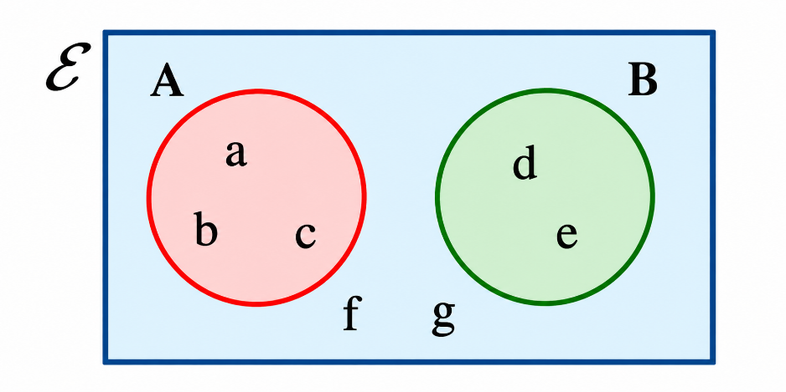

Fundamental Set Concepts
Key Sets
Venn Diagrams
Universal Set ($ℰ$ ): The set of all objects under consideration in a given problem.
Sets can be represented diagrammatically using Venn diagrams. The universal set is a rectangle, and sets within it are typically circles.
Empty Set ($∅$ or $\{\}$): The set containing no elements.

Slide 7





Important Sets of Numbers
1
Natural Numbers ($ℕ$)
2
Integers ($ℤ$)
The set of counting numbers: {1, 2, 3, 4, 5, ...}
The set of negative and positive whole numbers and zero:
$$\{… −3, −2, −1, 0, 1, 2, 3 …\}$$
3
Rational Numbers ($ℚ$)
4
Real Numbers ($ℝ$)
The set of numbers that can be expressed as a fraction, including integers.
All numbers on the number line, including rationals and irrationals.

Slide 8
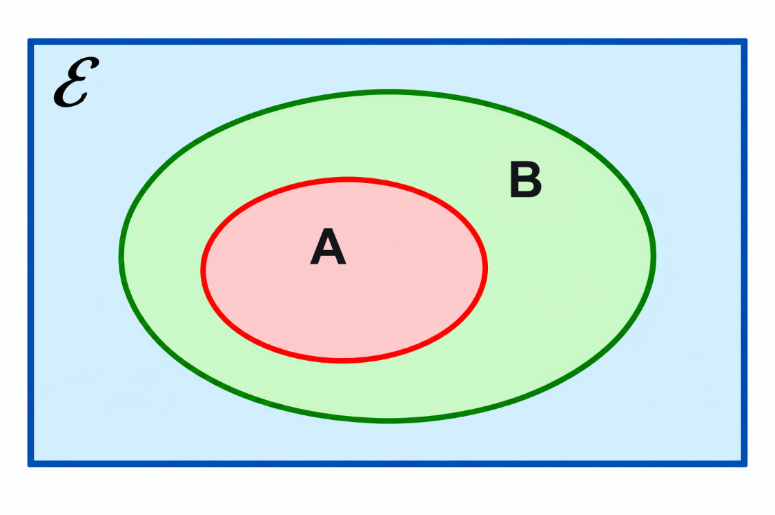
1.3 Operations on Sets
Subset (A ⊆ B)
Every element of A is also an element of B.
Proper Subset (A ⊂ B)
A is a subset of B, but A is not equal to B.

Slide 9
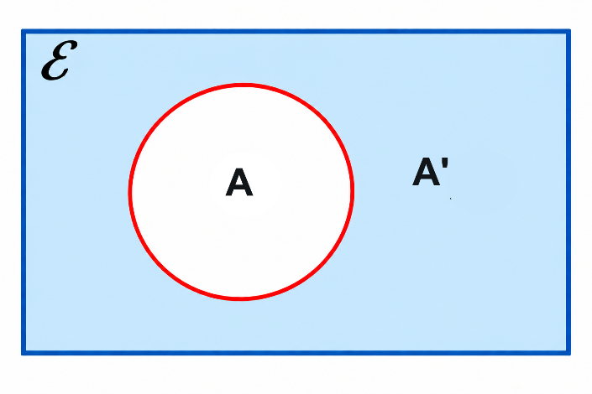
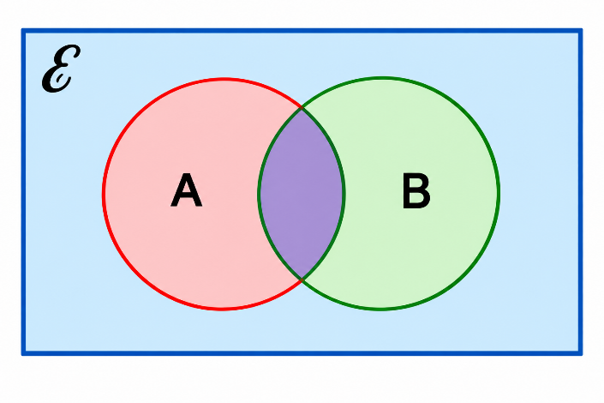
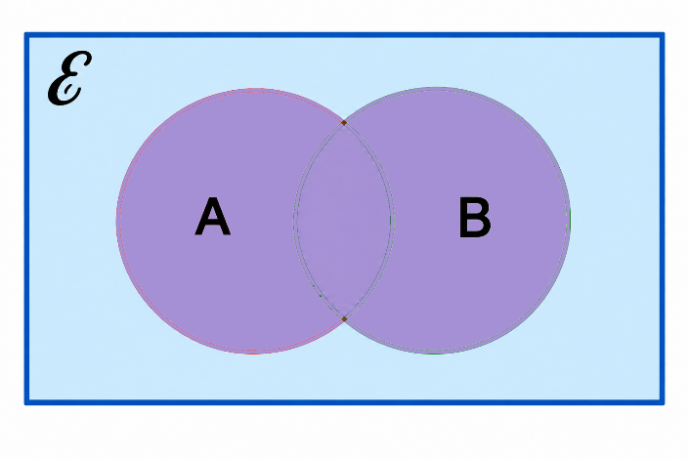


Set Operations
Complement (A')
Intersection (A $∩$ B)
Union (A $∪$ B)
Everything in the universal set that is NOT in A.
Elements that are in BOTH A and B.
Elements that are in A OR B OR both.

Slide 10
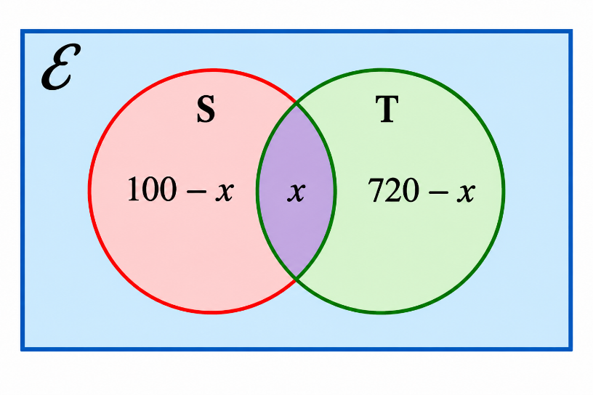

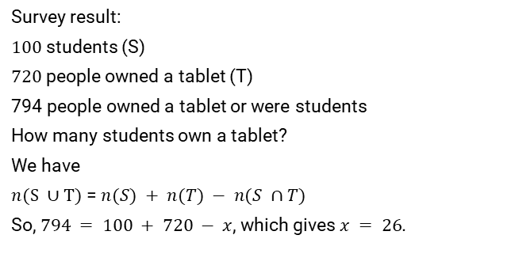
Cardinality of a Set
Example
The number of elements in a set is called its cardinality, written as $n(A)$ or $|A|$.
Survey result:
$100$ students (S)
$720$ people owned a tablet (T)
794 people owned a tablet or were students
How many students own a tablet?
We have
$n(S ∪T)$ =$n(S) + n(T) − n(S ∩T)$
So, $794 = 100 + 720 − x$, which gives $x = 26$.
$n(∅)$ = 0
$n(\{2\})$= 1
$n(\{a, b\})$= 2

Slide 11
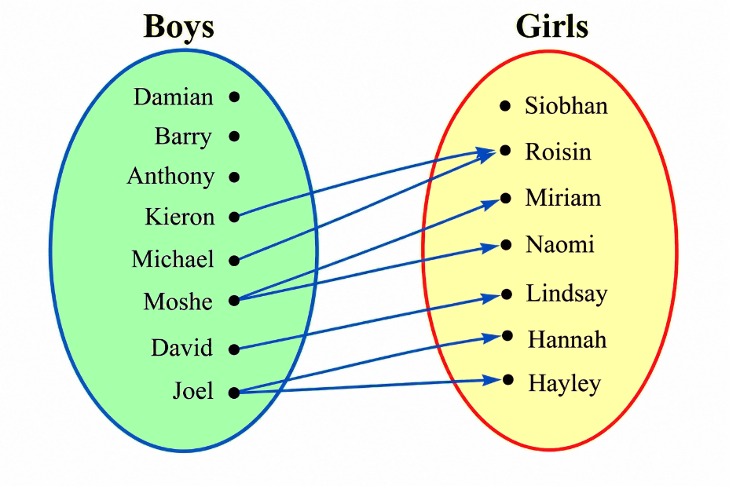
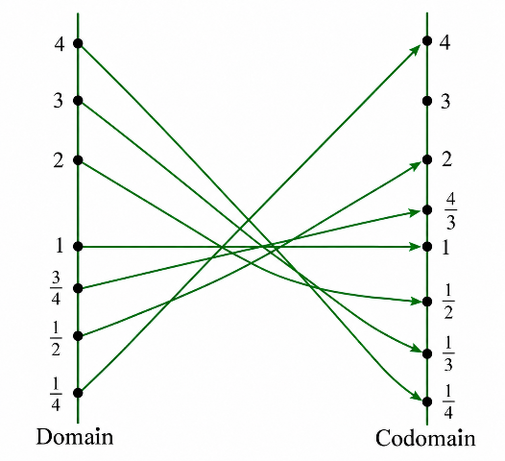
1.4 Relations and Functions
Relation
Function
A way of pairing members of two sets. An input can be paired with zero, one, or multiple outputs, like this example of boys and their sisters.
A special relation where each input value has exactly one output value. It's a reliable mathematical machine.
The function 1/x shown as a mapping diagram, x >0

Slide 12
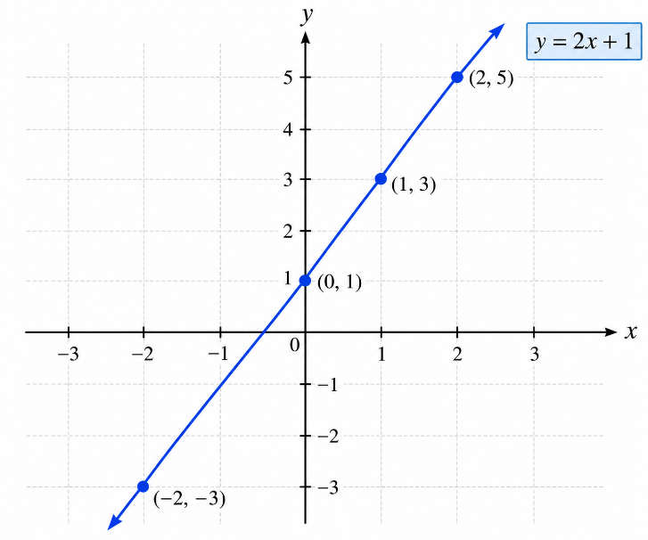
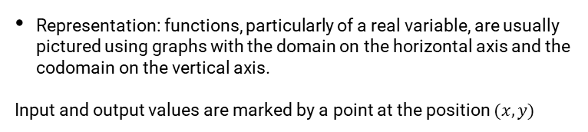
The Language of Functions
Domain: The set of all possible input values.
Codomain: A set containing all possible output values.
Image: The specific output value for a given input.
Notation: We write $f(x) = y$, where y is the image of $x$ under the function $f$.
Variables: $x$ is the independent variable, and $y$ is the dependent variable.
Representation: functions, particularly of a real variable, are usually pictured using graphs with the domain on the horizontal axis and the codomain on the vertical axis.
Input and output values are marked by a point at the position $(x, y)$

Slide 13
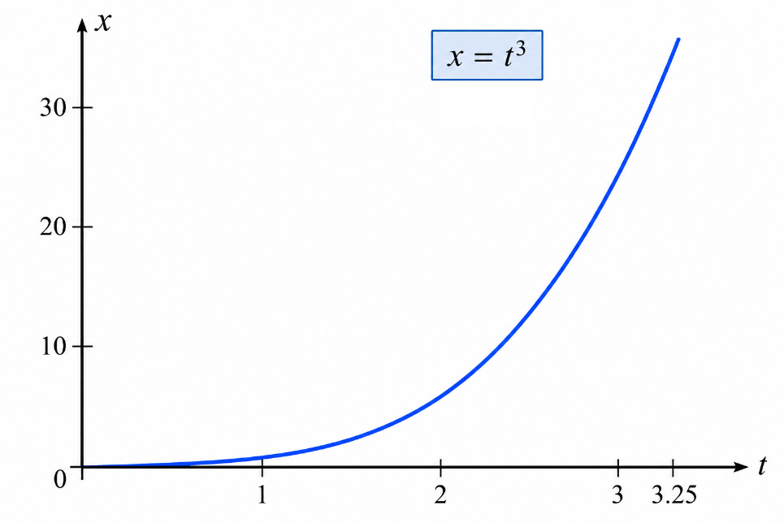
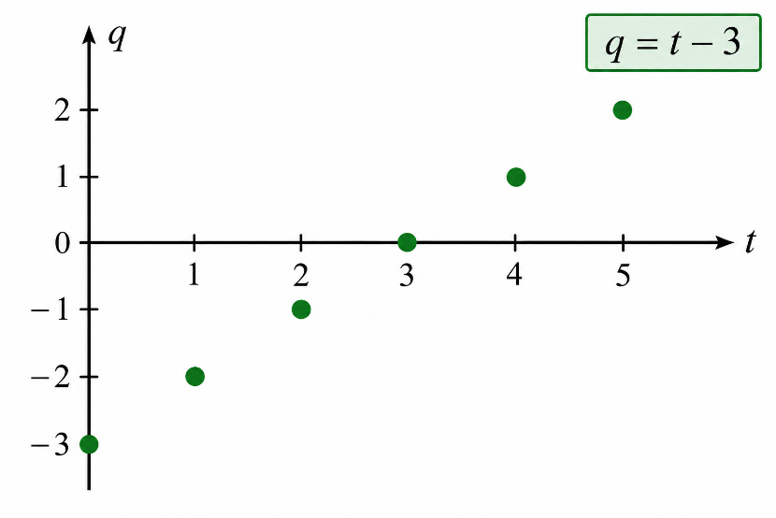
Continuous vs. Discrete Functions
Functions are used to represent signals. Analog signals are continuous, or piecewise continuous, while digital signals are discrete.
Continuous Functions
Discrete Functions
The function's graph can be drawn without lifting the pen. Represents analog signals.
The function is defined only at specific points. Represents digital signals.

Slide 14
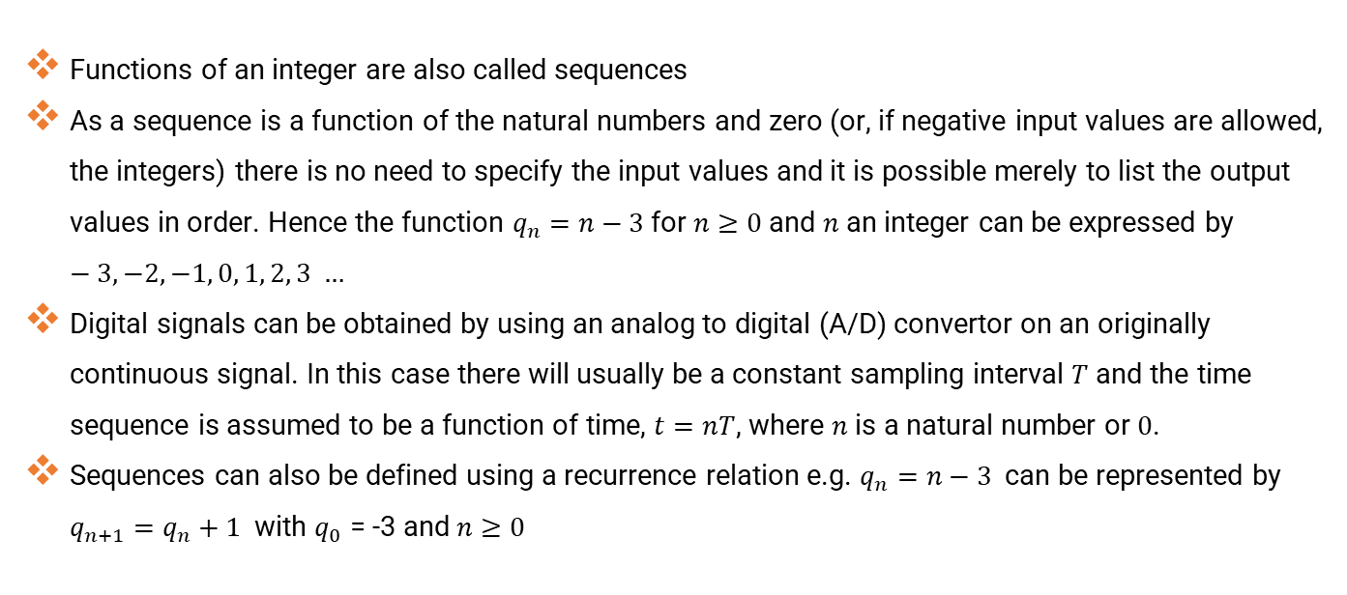
Discrete Functions, Sequences and Time Sequences
Functions of an integer are also called sequences
As a sequence is a function of the natural numbers and zero (or, if negative input values are allowed, the integers) there is no need to specify the input values and it is possible merely to list the output values in order. Hence the function $q_{n}=n−3$for $n≥0$and $n$ an integer can be expressed by $−3, −2, −1, 0, 1, 2, 3 …$
Digital signals can be obtained by using an analog to digital (A/D) convertor on an originally continuous signal. In this case there will usually be a constant sampling interval $T$ and the time sequence is assumed to be a function of time, $t=nT$, where $n$ is a natural number or $0$.
Sequences can also be defined using a recurrence relation e.g. $q_{n}=n−3$ can be represented by $q_{n+1}=q_{n}+1$ with $q_{0}$ = -3 and $n≥0$

Slide 15
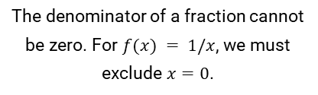
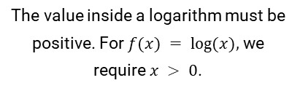
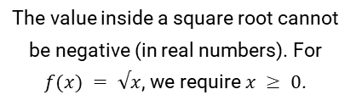
Undefined Function Values
Some numbers cannot be input into a function. These must be excluded from the domain. Things to look out for as values that are not allowed as function inputs are :
Division by Zero
Negative Square Roots
Negative/Zero Logarithms
The denominator of a fraction cannot be zero. For $f(x) = 1/x$, we must exclude $x=0$.
The value inside a square root cannot be negative (in real numbers). For $f(x) = √x$, we require $x ≥ 0$.
The value inside a logarithm must be positive. For $f(x) = log⁡(x),$ we require $x > 0$.

Slide 16

Combining Functions
Arithmetic Combinations
Sum: $\left(f + g\right):x↦ f(x) + g(x)$
Difference: $\left(f − g\right):x↦ f(x) − g(x)$
Product: $\left(f × g\right):x↦ = f(x) × g(x)$
Quotient: $\left(\frac{f}{g}\right):x↦\frac{f\left(x\right)}{g(x)}$ provided $g(x) ≠ 0$

Slide 17
Composition of Functions
Composition is performing one function followed by another: a function of a function. The order matters!
Let $f(x) = 2x + 1$and $g(x) = x²$
$g(f(x))$or $(g ∘ f)(x)$
$f(g(x))$or $(f ∘ g)(x)$
First $f$, then $g$:
First $g$, then $f$:
$$g(2x + 1) = (2x + 1)²$$
$$f(x²) = 2(x²) + 1 = 2x² + 1$$

Slide 18
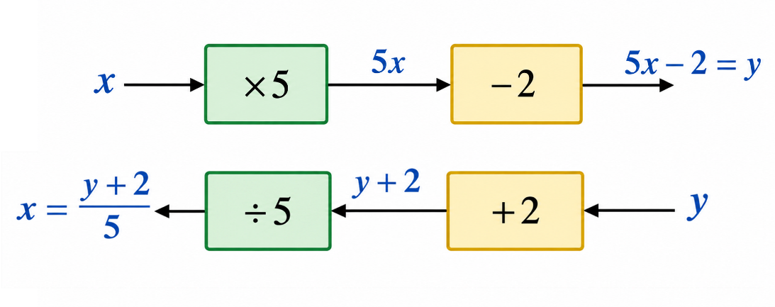

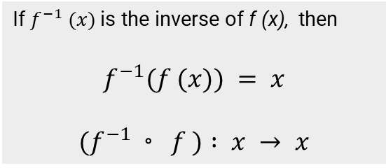
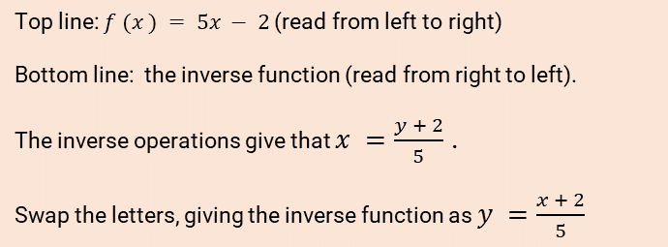
Decomposing Functions and Finding the Inverse
A composite function can be broken into different stages, each represented by its own box. The inverse of a function is a function which will take the image under the function back to its original value.
Example: $f (x) = 5x − 2$and its inverse
Top line: $f (x ) = 5x − 2$(read from left to right)
Bottom line: the inverse function (read from right to left).
The inverse operations give that $x =\frac{y + 2}{5}$ .
Swap the letters, giving the inverse function as $y =\frac{x + 2}{5}$
Finding the Inverse
If $f^{−1} (x)$is the inverse of f (x), then
$$f^{−1}(f (x)) = x$$
$$(f^{−1}◦ f ) : x → x$$
Write the function as $y = f(x)$
Rearrange the equation to make x the subject (solve for $x$ in terms of $y$).
Swap the letters x and y. The new expression for y is $f^{−1} (x)$

Slide 19
1.6 Summary
Functions are used to express relationships between physical quantities.
A set is a collection of elements.
Key set operations are intersection ($∩$), union ($∪$), and complement (A').
The set of all inputs to a function is the domain of the function. The set including all the outputs is called the codomain.
Functions are special relations where each input has exactly one output.
Analog signals are represented by continuous, or piecewise continuous, functions; digital signals by discrete functions (sequences).
Functions can be combined via arithmetic operations or composition (function of a function).
The inverse of a function is a function which will take the image under the function back to its original value $f^{−1}(f (x)) = x$

