Slide 1

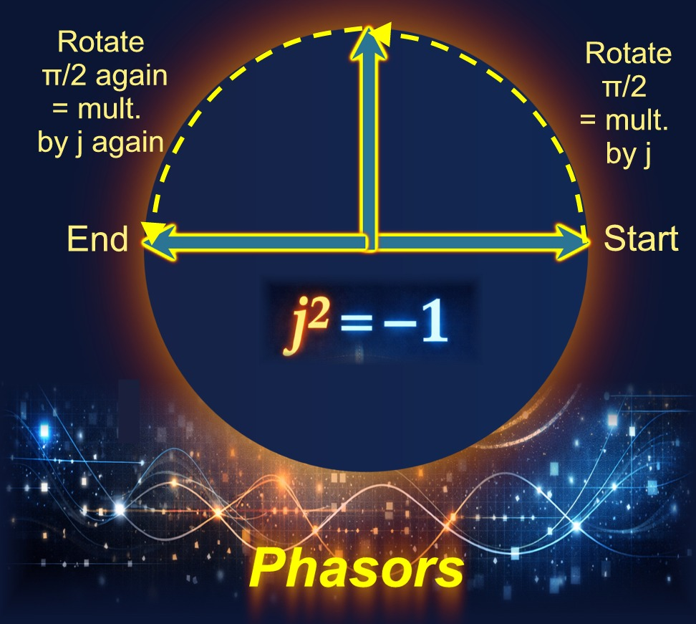
Complex Numbers

Slide 2
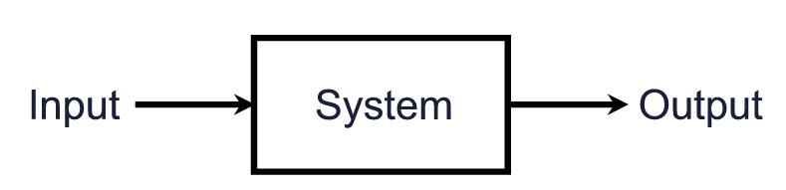
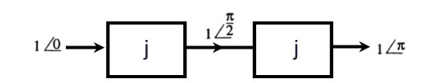



Introduction to Complex Numbers
A single frequency wave can be represented by a rotating vector called a phasor. Linear systems can alter this wave by scaling its amplitude and shifting its phase. Using complex numbers, this entire system transformation can be represented by a simple multiplication.
The Imaginary Unit, j
We define '$j$' as an operator that rotates a phasor by $π/2$ ($90°$) without changing its amplitude.
Multiplying by $j$ rotates a phasor by $π/2$.
Multiplying by $j$ twice ($j×j$) rotates the phasor by π ($180°$), which is equivalent to multiplying by $−1$.
This leads to the fundamental definition of the imaginary unit: $j² = −1$.

Slide 3
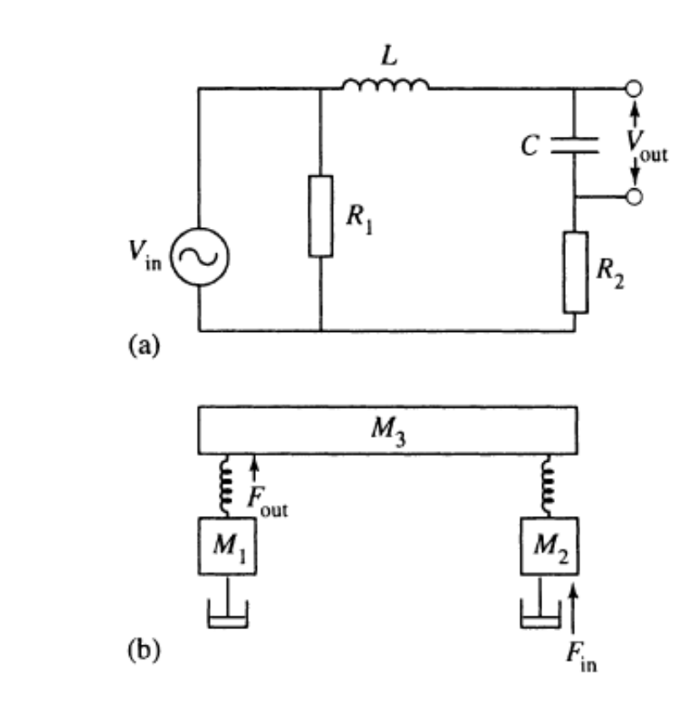
Linear Systems and Phasors
A system is often represented as a box with an input and an output. We are interested in linear systems where a single-frequency wave input produces an output at the same frequency, but with a potentially different amplitude and phase.
Electrical Systems
Mechanical Systems
Circuits made of resistors, capacitors, and inductors are a prime example. The input and output are typically voltages.
Equivalent mechanical systems consist of masses, springs, and dampers. The input might be an external force and the output a displacement or tension.

Slide 4
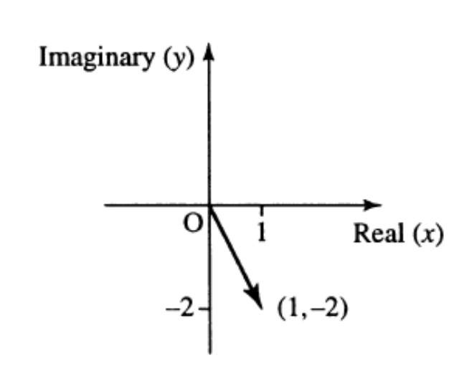
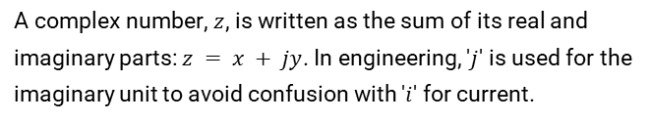
Representing Complex Numbers
Real and Imaginary Parts
The Complex Plane
A complex number, $z$, is written as the sum of its real and imaginary parts: $z = x + jy$. In engineering, '$j$' is used for the imaginary unit to avoid confusion with '$i$' for current.
Complex numbers are visualized on a 2D plane, often called an Argand diagram. The horizontal axis represents the real part, and the vertical axis represents the imaginary part.
$x$ is the real part: $Re(z) = x$
$y$ is the imaginary part: $Im(z) = y$

Slide 5
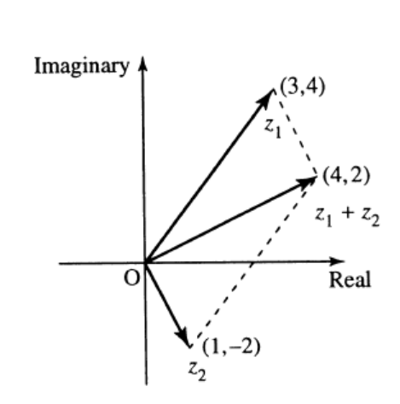
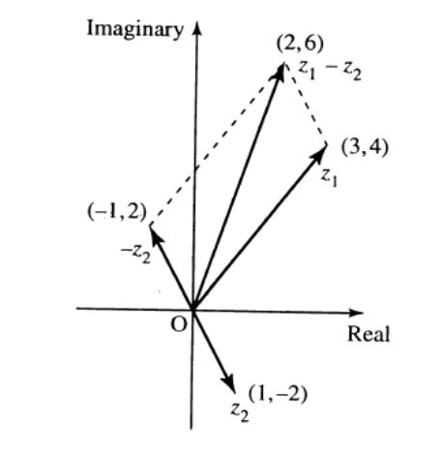
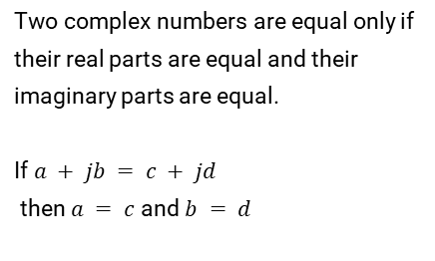
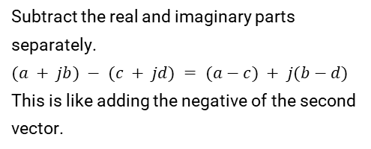
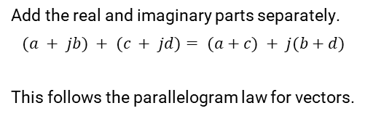
Basic Operations with Complex Numbers
Equality
Addition
Subtraction
Two complex numbers are equal only if their real parts are equal and their imaginary parts are equal.
If $a + jb = c + jd$
then $a = c$and $b = d$
Add the real and imaginary parts separately.
$$(a + jb) + (c + jd)= (a+c) + j(b+d)$$
This follows the parallelogram law for vectors.
Subtract the real and imaginary parts separately.
$(a + jb) − (c + jd) = (a−c) + j(b−d)$
This is like adding the negative of the second vector.

Slide 6
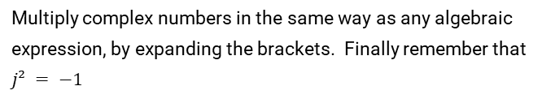


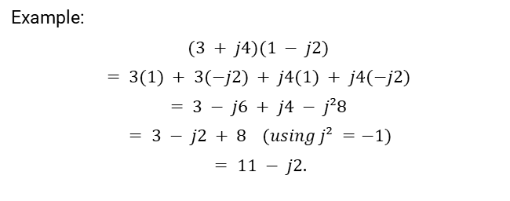
Multiplication and Conjugates
Multiplication
The Complex Conjugate
Multiply complex numbers in the same way as any algebraic expression, by expanding the brackets. Finally remember that $j² = −1$
The conjugate of $z = x + jy is z∗ = x − jy$
Geometrically, it's a reflection across the real axis.
A number multiplied by its conjugate is always a real, non-negative number.
Example:
$$(3 + j4)(1 − j2)$$
$$= 3(1) + 3(−j2) + j4(1) + j4(−j2)$$
$$= 3 − j6 + j4 − j²8$$
$$= 3 − j2 + 8 (using j² =−1)$$
$$= 11 − j2.$$
$z z∗ = (x + jy)(x − jy) = x² + y²$
This value is also the square of the number's magnitude (modulus): $|z|²$

Slide 7
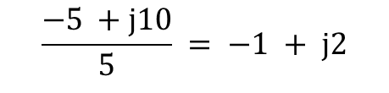
Division of Complex Numbers
To divide complex numbers, we make the denominator a real number. This is done by multiplying both the numerator and the denominator by the complex conjugate of the denominator.
Example: $\frac{3 + j4}{1 − j2}$
Step 1: Multiply top and bottom by the conjugate of the denominator $(1 + j2)$
Fraction becomes: $\frac{\left(3 + j4\right)\left(1 + j2\right)}{\left(1 − j2\right)\left(1 + j2\right)}$
Step 2: Expand the numerator and denominator.
Numerator: $(3 + j6 + j4 + j²8) = (3 + j10 − 8) = −5 + j10$
Denominator: $1² + 2² = 1 + 4 = 5$
Step 3: Simplify the result:
$$\frac{−5 +j10}{5} = −1 + j2$$

Slide 8
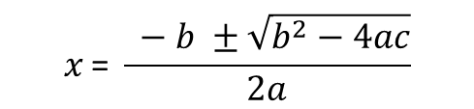
Solving Quadratic Equations
Complex numbers provide a way to find solutions for any quadratic equation of the form $ax² + bx + c = 0$
The Formula:
$$x \text{= }\frac{ −b ±\sqrt{b^{2}−4ac}}{2a}$$
When b² - 4ac < 0, the term inside the square root is negative, which meant, when we only considered real numbers, there were no solutions.
With complex numbers, when $b² − 4ac < 0$we can write $\sqrt{b^{2}− 4ac}$as$j\sqrt{4ac − b^{2}}$
This means the solutions will be a pair of complex conjugates of the form $p ± jq$
Therefore, if you know one complex root of a quadratic equation with real coefficients, the other root is simply its conjugate.

Slide 9
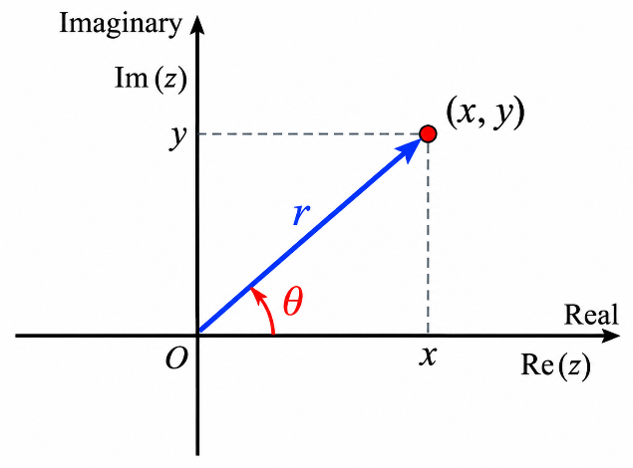

Polar Form of a Complex Number
Instead of Cartesian coordinates $(x, y)$, we can describe a complex number using its distance from the origin (modulus, r) and its angle from the positive real axis (argument, $θ$). This is the polar form: $r∠θ$
Cartesian to Polar
Polar to Cartesian
Modulus: $r = |z| = √(x² + y²)$
Real Part: $x = r cos⁡(θ)$
Argument: $θ = tan⁻¹(y/x)$(with adjustment for the correct quadrant)
Imaginary Part: $y = r sin⁡(θ)$

Slide 10
Operations in Polar Form
While addition and subtraction require conversion to Cartesian form, multiplication and division become much simpler in polar form.
Multiplication
Division
To multiply, multiply the moduli and add the arguments.
To divide, divide the moduli and subtract the arguments.
(r₁∠θ₁) $⋅$ (r₂∠θ₂) = $(r₁r₂)∠$($θ₁ + θ₂$)
(r₁∠θ₁) / (r₂∠θ₂) = (r₁/r₂)∠(θ₁ - θ₂)

Slide 11
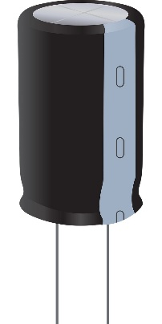
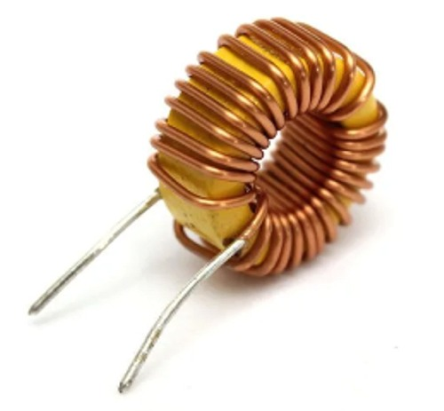


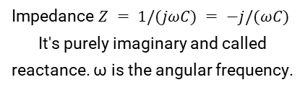

Application: AC Circuit Analysis
Complex numbers are fundamental to analysing alternating current (AC) circuits. The relationship between voltage ($V$), current ($I$), and impedance ($Z$) is a complex version of Ohm's Law: $V = ZI$
Resistor
Capacitor
Inductor
Impedance $Z = R$
It's a purely real value representing resistance.
Impedance $Z = 1/(jωC) = −j/(ωC)$
It's purely imaginary and called reactance. ω is the angular frequency.
Impedance $Z = jωL$
It's also a purely imaginary reactance.

Slide 12
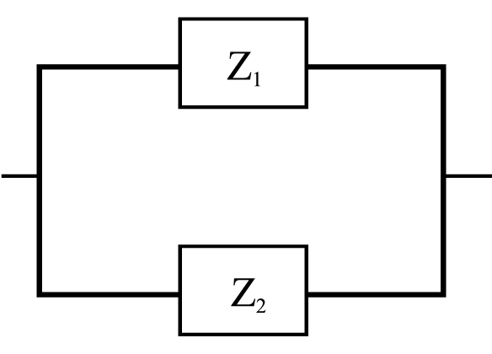
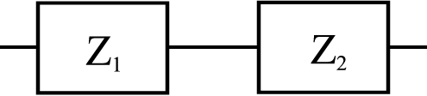

Combining Impedances
Series Circuits
Parallel Circuits
For components in series, the total impedance is the sum of the individual impedances.
For parallel components.
$$1/Ztotal = 1/Z₁ + 1/Z₂$$
or $Ytotal = Y₁ + Y₂$
$$Ztotal = Z₁ + Z₂$$

Slide 13
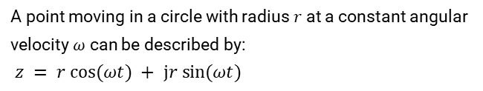


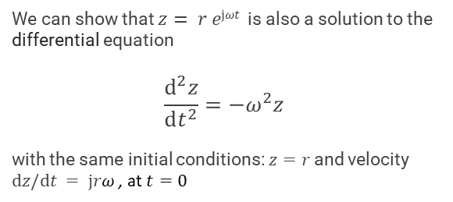
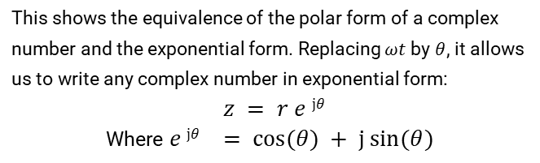
Circular Motion, Polar and Exponential Form
The Rotating Vector
Exponential form
A point moving in a circle with radius $r$ at a constant angular velocity $ω$ can be described by:
$z = r cos⁡(ωt) + jr sin⁡(ωt)$
We can show that $z= r ejωt$is also a solution to the differential equation
$$\frac{d^{2}z}{dt^{2}}=−ω^{2}z$$
with the same initial conditions:$z=r$and velocity $dz/dt = jrω$, at $t=0$
z is a solution to the differential equation
which defines simple harmonic motion.
$$\frac{d^{2}z}{dt^{2}}=−ω^{2}z$$
So,
$$r e jωt =rcos⁡(ωt) + jr sin⁡(ωt)$$
This shows the equivalence of the polar form of a complex number and the exponential form. Replacing $ωt$ by $θ$, it allows us to write any complex number in exponential form:
$z = r e jθ$
Where $e jθ = cos⁡(θ) + j sin⁡(θ)$

Slide 14
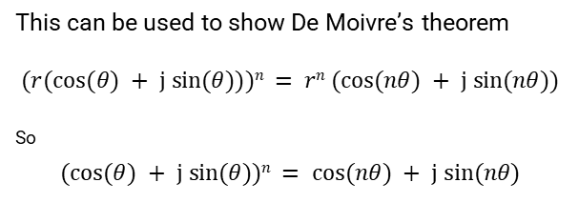
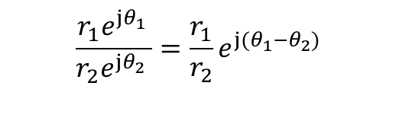


The Exponential Form
The exponential form z = r e ^{jθ} simplifies complex number operations as we can use the standard rules of exponents.
1
Multiplication
2
Division
3
Powers
$$\frac{r_{1}e^{{jθ}_{1 }}}{r_{2}e^{jθ_{2}} }=\frac{r_{1}}{r_{2}}e^{j(θ_{1}−θ_{2})}$$
$r_{1}e^{jθ_{1}}$ $r_{2}e^{jθ_{2}}=r_{1}r_{2}e^{j(θ_{1}+θ_{2})}$
$(r e jθ )n$= $r n e jnθ$
This can be used to show De Moivre’s theorem
$$(r(cos⁡(θ) + j sin⁡(θ)))n = rn (cos⁡(nθ) + j sin⁡(nθ))$$
^{So}
$$(cos⁡(θ) + j sin⁡(θ))n = cos⁡(nθ) + j sin⁡(nθ)$$

Slide 15
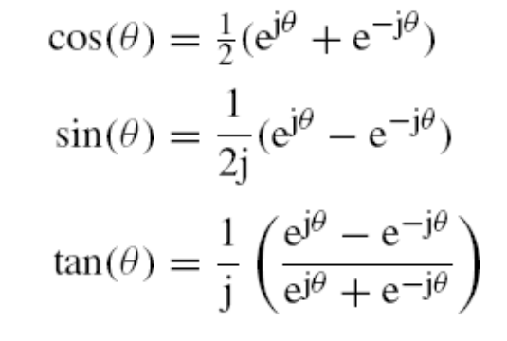



Trigonometric and Hyperbolic Functions
Using e ^{jθ} = cos(θ) + j sin(θ) we can find expressions linking trigonometric and hyperbolic functions.
Trigonometric Expressions
Link to Hyperbolic Functions
$cos⁡(jθ) = cosh⁡(θ)$
$sin⁡(jθ) = j sinh⁡(θ)$
$tan⁡(jθ) = j tanh⁡(θ)$

Slide 16
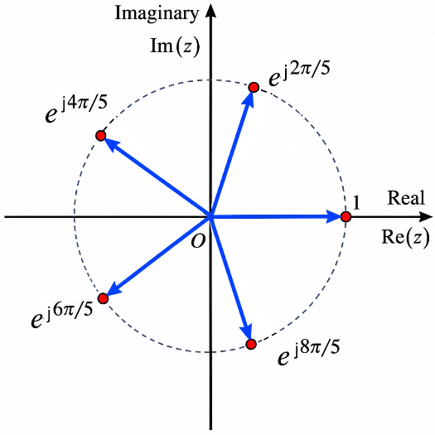


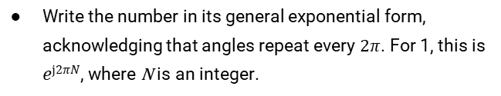
Solving Equations: The Roots of Unity
The exponential form is invaluable for finding the $n$-th roots of a complex number, such as solving the equation $zⁿ = 1$, known as finding the '$n$-th roots of unity'.
The Method
The Result
Write the number in its general exponential form, acknowledging that angles repeat every $2π$. For 1, this is $ej2πN$, where N is an integer.
The n roots are always evenly spaced around a circle in the complex plane, e.g. the 5th roots of unity below.
The equation becomes $zⁿ = ej2πN$
Take the $n$-th root of both sides:
$$z = e^{\frac{j2πN}{n}}$$
Let $N = 0, 1, 2, … , n−1$to find the n distinct roots.

Slide 17







Summary
Complex Numbers
Operations
Applications
Add/Subtract in Cartesian
$j² = −1$
Solving quadratics
Cartesian form: $z = x + jy$
Multiply/Divide in Polar/Exponential
AC circuit analysis ($V=ZI$)
Polar form: $z = r∠θ$
Describing circular motion & waves
Exponential form: $z = re jθ$
Use conjugate for division
Powers: $\left(rejθ\right)n = rnejnθ$
Key Formulas
Euler’s formula: $ejθ = cos⁡(θ) + j sin⁡(θ)$
De Moivre's Theorem: $(cos⁡(θ) + j sin⁡(θ))n = cos⁡(nθ) + j sin⁡(nθ)$

